Slide 1
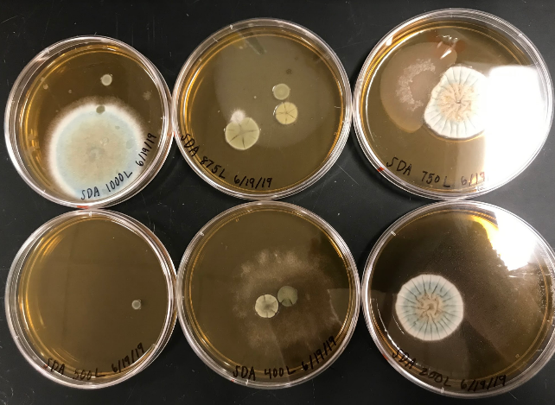
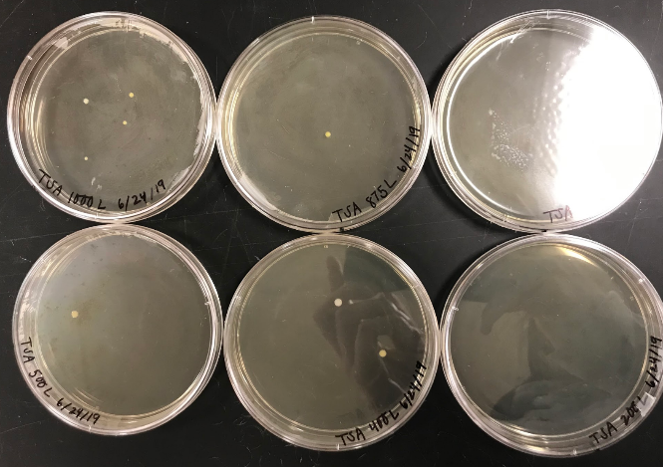
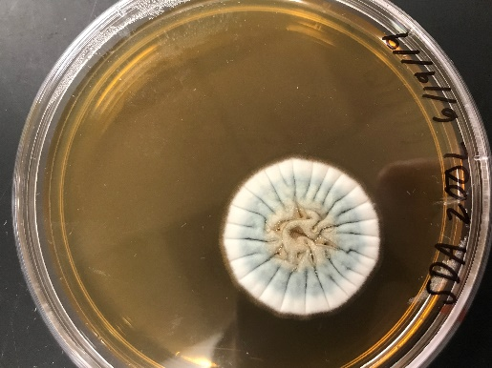
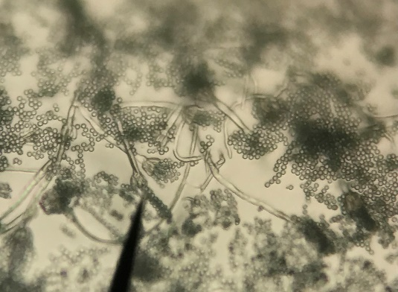
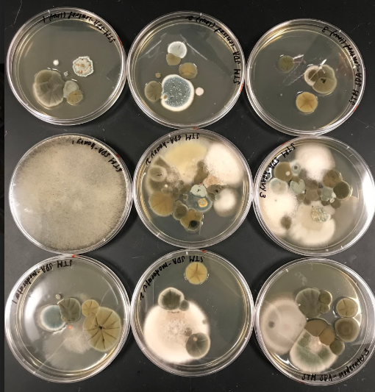
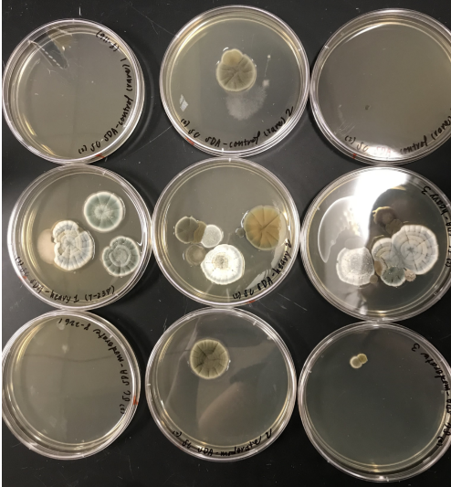
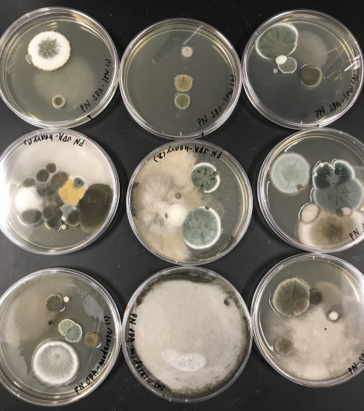
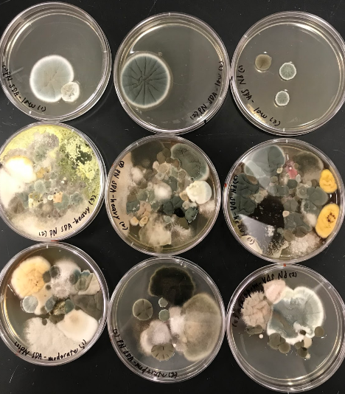
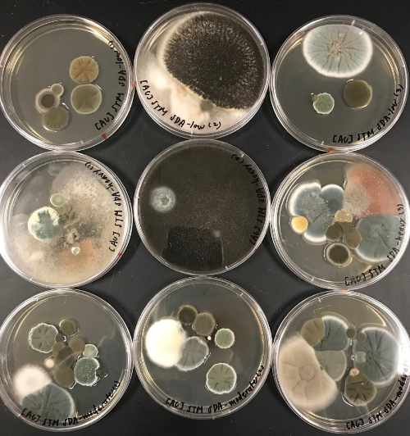
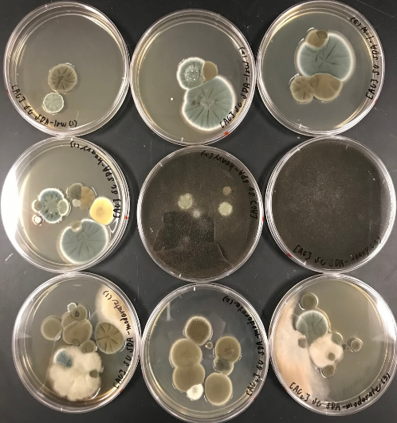
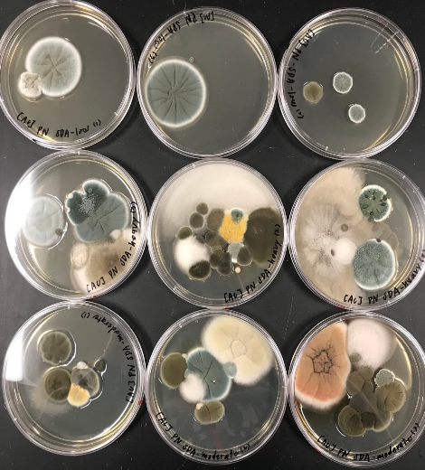
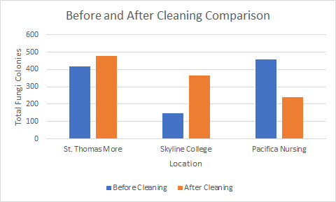
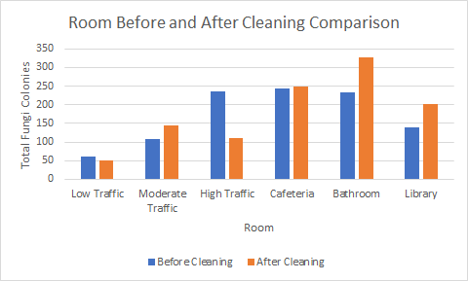
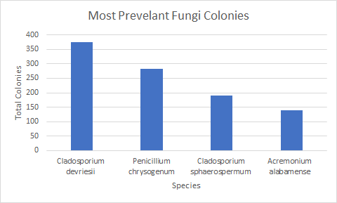
Microorganisms Found in Built Environments Influenced by Age of Occupants
Shannon Chau
Eastern Nazarene College
INTRODUCTION
MATERIAL AND METHODS
CONCLUSION
Built environments are human-made environments that provides settings for human activities. They host communities of different microorganisms such as fungi and bacteria that human encounter on daily basis and have multiple influences such as, temperature, moisture, humidity, ventilation, building design, animals, and humans. Humans are the greatest influence of built environments as we shed approximately 10,000,000 bacteria/hour per person. Humans also have three specific microbiome that influences built environments, the skin, gut, and oral. Gender influences microorganisms present as well.
Presence of microorganism diversity and richness can indicate air quality. High volumes of microorganisms could be possibly dangerous to human health and if airborne pathogens are inhaled it can cause health problems and undesirable effects.
It is important to study built environment because it can lead to relevant information to optimize indoor environment, improve of health and productivity of the area, and prevent sickness of occupants.
Ideal Volume and Conditions Test:
To find most ideal condition for fungi and bacteria growth volumes of: 1000 L, 875 L, 750 L, 500 L, 200 L were taken on sabouraud dextrose agar (SDA) plates and trypticase soy agar (TSA) plates with Microbio MB2 BioAerosol Sampler. The SDA plates were stored in 20-25℃ incubator for 3-7 days and the TSA plates were stored in 28-35℃ incubator for 1-2 days.
Ideal Conditions Test Results:
The most ideal condition was found to be the SDA plate at 875 L incubated at 25℃ for 7 days. This is because SDA plates are ideal for fungi growth with a pH of 5 (too acidic for bacteria). While TSA plate are general-purpose, nonselective media, and commonly grows bacteria.
Age and Cleaner Test
The results from the ideal conditions test were applied to all plates taken. Samples were taken from St. Thomas More (elementary school), Skyline College, Pacifica Nursing Home. Three plates sampled from: low, moderate, high trafficked room, cafeteria, bathroom, library. Two trials were taken at leach location. The same method was repeated but samples were taken after the location was cleaned.
Experimental Analysis
To identify species of bacteria and fungi observational analysis used to evaluate color(s), size, texture, and growth patterns. Microscopic analysis was done by using tape and light microscope. Tape was tapped lightly on the surface of a fungi colony to pick up spores, then placed onto a slide for observation. Its appearance was used identified the species of fungi through the following literature: “Practical Laboratory Mycology,” “Medical Mycology and Human Mycoses,” “Laboratory Manual for Introductory Mycology,” and “Identifying Filamentous Fungi.”
Data Analysis
For each location recorded, date, data on the type of plate, quantities, species, and physical characteristics are kept in their own tables. Total colonies of bacteria and fungi at each location will be summarized and compared to show the number of fungi at each location and room before and after cleaning. The most prevalent fungi present overall will be analyzed through excel spreadsheet. A t-tests, calculated through excel, will be used to test if there are significant differences in means of the fungi colonies between locations and rooms before and after cleaning
Influence of age
Elementary school environments contained more fungi colonies than college or nursing home environments before cleaning, however, the nursing home also indicated high levels of fungi. This results could be due to lifestyle habits.
Influence of room type
Before cleaning, rooms with the most human activity had the highest level of fungi and low foot trafficked rooms yielded the lowest amounts of fungi.
Most prevalent fungi colonies
Popular species were mostly found to live on plants, soil, and animals. This is because skin microbiomes have a direct relationship with built environments due to contact.
This data can be useful in real-world applications, children and the elderly have lower immune systems and are more prone to disease and sickness. Having a higher concentration of bacteria and fungi in their environment encourages sickness and infection. To prevent this more frequent cleanings and disinfecting are needed. Weekly cleanings are not sufficient in deterring bacteria and fungi growth.
OBJECTIVES
Figure 7. SDA ideal conditions result
Figure 8. TSA ideal conditions result
Figure 9. Penicillium chrysogenum colony
Figure 10. Penicillium chrysogenum spores
The objective of this research is to studying microorganisms in nursing homes, college, and elementary school to provide universally relevant information to optimize indoor environments and improve the health of occupants. To do this, I will find the influence of age and its effects on built environments since this information is still unknown. Richness and volume of microorganisms associated with the common infectious disease may be associated by age. I will investigate if there is true determinant to prevent future sickness and decrease richness and diversity of microorganisms present, such as a specific cleaner and cleaning methods.
To do so, air from different age based built environments will be collected before and after cleaning to investigate if they contain similar species, richness, and diversity of microorganisms. Identical volumes at each location will be taken, stored in the same conditions, and observed
I Hypothesize that elementary schools will have the highest frequencies of bacteria linked with common diseases, however, use of cleaning solutions, such as Lysol, bleach solution, or Clorox will decrease the amount.
REFERENCES
Adams, R.I., Miletto, M., Taylor, J.W., and Bruns, T.D. 2013. Dispersal microbes: fungi in indoor air are dominated by outdoor air and show dispersal limitation at short distances. ISME Journal 7(7): 1460.
Chase, John et al. “Geography and Location Are the Primary Drivers of Office Microbiome Composition.” Ed. Jack A. Gilbert. mSystems 1.2 (2016): e00022–16.
Dunn, R.R., Fierer N., Henley, J.B., Leff, J.W., and Menninger, H.L. 2013. Home life: factors structuring the bacterial diversity found within and between homes. PLOS One 8(5): e64133.
Gibbons, Sean M. “The Built Environment Is a Microbial Wasteland.” mSystems 1.2 (2016): e00033–16.
Hallen-Adams, H.E., and Suhr, M.J. 2017. Fungi in the healthy human gastrointestinal tract. Taylor & Francis Group 8(3): 352-258.
Hospodsky, D., Pickering, A.J., Julian, T.R., Miller, D., Gorthala, S., Boehm, A.B., and Peccia, J. 2014. Hand bacterial communities vary across two different human populations. Microbiology. 160(6): 1144-1152.
Hospodsky, D. , Yamamoto, N. , Nazaroff, W. W., Miller, D. , Gorthala, S. and Peccia, J. (2015), Characterizing airborne fungal and bacterial concentrations and emission rates in six occupied children's classrooms. Indoor Air, 25: 641-652.
Leung, M.H.Y., and Lee, P.K.H. 2016. The roles of the outdoors and occupants in contributing to a potential pan-microbiome of the built environment: a review. BioMed Central 4:21.
Leung, M.H.Y., Wilkins D., Li, E.K.T., Kong, F.K.F., and Lee, P.K.H. 2014. Indoor air microbiome in an urban subway network diversity and dynamics. American Society for Microbiology 80(21): 6760-6770.
Luongo, J.C., Barberan, A., Hacker-Cary, R., Morgan, E.E., Miller, S.L., and Fierer, N. 2017. Microbial analyses of airborne dust collected from dormitory rooms predict the sex of occupants. John Wiley & Sons Ltd 27: 338-344.
Meadow, J.F., Altrichter, A.E., Kembel, S.W., Kline, J., Mhuireach, G., Moriyama, M., Northcutt, D., O’Connor, T.K., Womack, A.M., Brown, G.Z., Green, J.L., and Bohannan, B.J. 2014. Indoor airborne bacterial communities are influenced by ventilation, occupancy, and outdoor air source. Indoor Air 24(1): 41-48.
Prussin, Aaron J., and Linsey C. Marr. “Sources of Airborne Microorganisms in the Built Environment.” Microbiome 3 (2015): 78. PMC.
Robertson, C.E., Baumgartner, L.K., Harris, J.K., Peterson, K.L., Stevens, M.J., Frank, D.N., and Pace, N.R. 2013. Cultural independent analysis of aerosol microbiology in a metropolitan subway system. American Society for Microbiology 79(11): 3485-3493.
Yamamoto, N., Hospodsky, D., Dannemiller, K.C., Nazaroff, W.W., and Peccia, J. 2015. Indoor emissions as a primary source of airborne allergic fungal particles in classrooms. Environmental Science Technology 49: 5098-5106.
Yoon-Seong, J., Chun, J., and Kim, B.S. “Identification of Household Bacterial Community and Analysis of Species Shared with Human Microbiome.” Current Microbiology 67.5 (2013): 557–563.
RESULTS
Before cleaning:
Skyline College had the least amount of fungi, followed by St. Thomas More then Pacifica Nursing Home. Combining the two trials, Skyline College yielded a sum of 148 colonies, St. Thomas More yielded 419 colonies, and Pacifica Home had 456 colonies. Indicating that Skyline College had the cleanest air conditions. Busier rooms with more human activity had the highest amounts of fungi and vise versa.
After cleaning:
The total amount of fungi colonies increased at Skyline College, stayed consistent at St. Thomas More, and decreased at Pacifica Nursing. Room types across all locations also yielded inconsistent varying results.
Analyzing results:
A T-test was done to compare locations before and after cleaning. The age-based location before and after cleaning yielded a value of 0.44 and the room types across all locations before and after cleaning yielded a value of 0.37. Because these values are so small, they are not statistically significant, indicating no major change before and after cleaning.
Most prevalent fungi colonies:
All locations had similar prevalent species before and after cleaning.
Figure 1. St. Thomas More trial 1 trafficked room results
Figure 2. Skyline College trial 1 trafficked room results
Figure 3. Pacifica Nursing Home trial 1 trafficked room results
AWKNOWLEDGEMENT
Thank you to Skyline College and Dr. Case for allowing me to use their facility and guiding me through the experimental process of this research project. Thank you to the Eastern Nazarene College staff, Professor Twining, Dr. Waterman, and Dr. Robinson for guiding me through the literature process of this research project.
Figure 4. St. Thomas More trial 1 trafficked room results after cleaning
Figure 5. Skyline college trial 1 trafficked room results after cleaning
Figure 6. Pacifica Nursing Home trial 1 trafficked room results after cleaning
Figure 11. This figure shows the total colonies of fungi at each location before cleaning and after cleaning.
Figure 12. This figure shows the total colonies of fungi in each room across all locations before cleaning and after cleaning.
Figure 13. The most prevalent fungi colonies before cleaning across all locations and room types.

