Slide 1
The Mutagenic Potential of Electronic Cigarette Flavorings
By Garrett Edinger

Slide 2
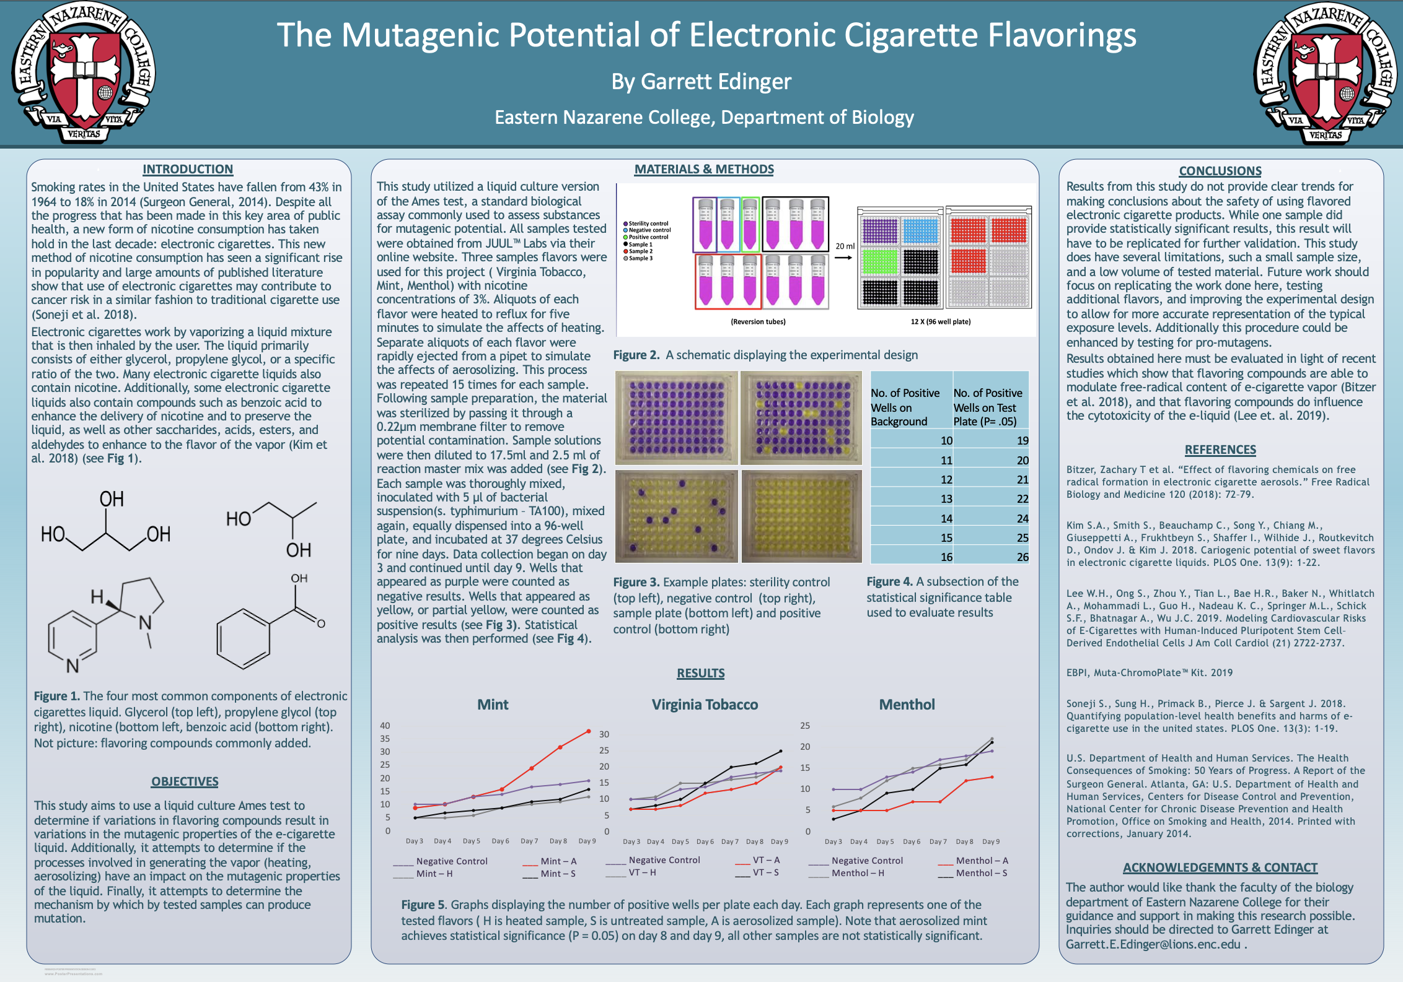

Slide 3
What Are Electronic Cigarettes ?
Electronic Cigarettes are devices that use a heating system and an aerosolizer to create a vapor that is meant to simulate the effects of regular cigarettes
Originally developed as a smoking cessation tool, they have become a new way to deliver nicotine

Slide 4
Why Is this research important?
According to the CDC over 9 million US adults use electronic cigarettes
According to pew research an increasing number of teens and young people report having used electronic cigarettes in the last 30 days

Slide 5
What are the contents of the e-liquid?
Glycerol
Propylene glycol
Nicotine
Benzoic acid
Flavoring compounds

Slide 6
What are the consequences of using electronic cigarettes?
Electronic cigarettes are still relatively new, so long-term longitudinal studies on their effects are not yet available
Some studies have detected known carcinogens, such as TSNAs, benzene, and heavy metals
Other studies have shown significantly altered protein expression in cells exposed to electronic cigarette vapor
The compounds found in the vapor can vary widely from one device to another and depend on the composition of e-liquid, type of device, and the heating system used

Slide 7
Goals of the Study:
To determine if e-cigarette liquid possesses mutagenic properties
If the e-cigarette liquid is shown to be mutagenic, to determine the mesons by which it produces mutations
To compare what effect, if any, flavoring compounds have on the mutagenicity of e-cigarette liquid
To compare what affect, if any, the processes of aerosolization and heating have on the mutagenicity of e-cigarette liquid

Slide 8
How will these goals be accomplished
Using the Ames test, developed in the 1970s by Bruce Ames and his team at UC Berkeley
Uses bacteria with mutations in genes required for amino acid synthesis(usually histidine or tryptophan)
The bacteria are exposed to the substance that is suspected of causing mutations
The number of reverse mutants is related to the mutagenicity of the compound

Slide 9
Materials:
1 Muta-Chrome Plate test kit
Syringe filters & Syringes
Glassware
Heating mantle
Juul Labs electronic cigarette pods (3 flavors)
Micropipettes and Tips
serological pipettes
Sterile 50 ml tubes
Sterile 96-well microplates
Incubators

Slide 10
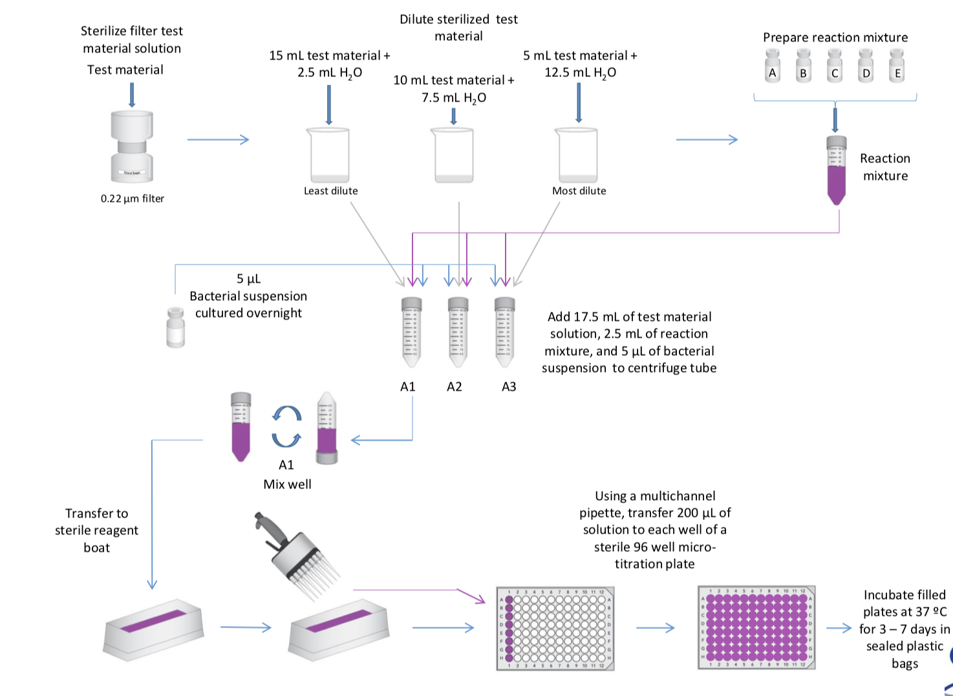
Materials & Methods
This study utilized a liquid culture version of the Ames test, a standard biological assay commonly used to assess substances for mutagenic potential. All samples tested were obtained from JUUL™ Labs via their online website. Three samples flavors were used for this project ( Virginia Tobacco, Mint, Menthol) with nicotine concentrations of 3%. Aliquots of each flavor were heated to reflux for five minutes to simulate the affects of heating. Separate aliquots of each flavor were rapidly ejected from a pipet to simulate the affects of aerosolizing. This process was repeated 15 times for each sample. Following sample preparation, the material was sterilized by passing it through a 0.22µm membrane filter to remove potential contamination. Sample solutions were then diluted to 17.5ml and 2.5 ml of reaction master mix was added (see Fig 2). Each sample was thoroughly mixed, inoculated with 5 μl of bacterial suspension(s. typhimurium – TA100), mixed again, equally dispensed into a 96-well plate, and incubated at 37 degrees Celsius for nine days. Data collection began on day 3 and continued until day 9. Wells that appeared as purple were counted as negative results. Wells that appeared as yellow, or partial yellow, were counted as positive results. Statistical analysis was then performed.

Slide 11
Test Set-Up:
My test will be using a liquid culture
More sensitive than the pour-plate assay
Using 96-well plates (one per sample)
Test uses an indicator (Bromocresol purple) to determine bacterial growth, and thus the number of reverse mutants
Sterility Control
Background plate
Test plate
Positive Control

Slide 12
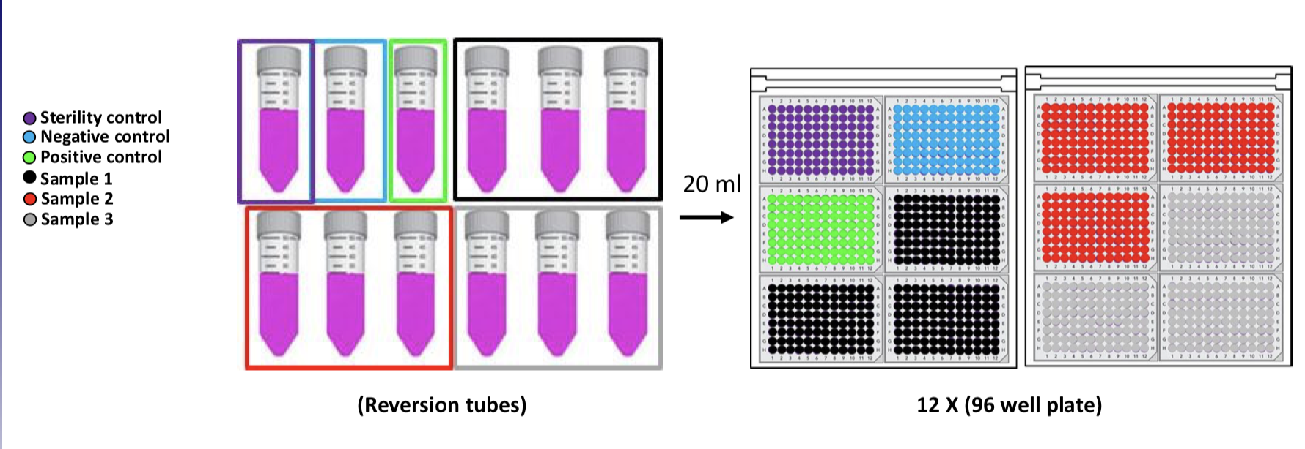
Sample Set Up:

Slide 13
Statistical Analysis
NO. of Wells + in background | NO. of wells + in test plate (p = .05) | NO. of wells + in test plate (p = .01) | NO. of wells + in test plate (p = .001)
4 | 10 | 14 | 19
5 | 12 | 15 | 20
6 | 13 | 17 | 21
7 | 15 | 18 | 23
Using a chart that comes with the kit to compare test plates to the background
Similar test for comparing test plates to each other (i.e. comparing heated to untreated sample)
Data should be analyzed based on day 5 results

Slide 14
Results:
 | Day 3 | Day 4 | Day 5 | Day 6 | Day 7 | Day 8 | Day 9
Sterility Control | 0 | 0 | 0 | 0 | 0 | 0 | 0
Positive Control | 22 | 34 | 60 | 70 | 81 | 85 | 85
Negative Control | 10 | 10 | 13 | 14 | 17 | 18 | 19
Mint - H | 5 | 5 | 6 | 9 | 10 | 11 | 13
Mint - S | 5 | 7 | 8 | 9 | 11 | 12 | 16
Mint - A | 9 | 10 | 13 | 16 | 24 | 32 | 38
VT - H | 10 | 11 | 15 | 15 | 16 | 17 | 20
VT - S | 7 | 8 | 10 | 15 | 20 | 21 | 25
VT - A | 7 | 7 | 8 | 12 | 13 | 15 | 20
Menthol - H | 6 | 8 | 12 | 15 | 16 | 17 | 22
Menthol - S | 3 | 5 | 9 | 10 | 15 | 16 | 21
Menthol - A | 5 | 5 | 5 | 7 | 7 | 12 | 13

Slide 15
Results
Mint
Virginia Tobacco
Menthol
____ Negative Control ___ Mint – A
____ Mint – H ___ Mint – S

Slide 16
Conclusions
Only one of the tested samples produced statistically significant results, however more work should be to do determine what role flavoring compounds might play in the mutagenicity of e-cigarette vapor
Future work should focus several things
  Replicating this work
  Expanding the work to include more flavors and more representative samples
  Expanding the test to look for pro-mutagens
Results obtained here must be evaluated in light of recent studies which show that flavoring compounds are able to modulate free-radical content of e-cigarette vapor (Bitzer et al. 2018), and that flavoring compounds do influence the cytotoxicity of the e-liquid (Lee et. al. 2019).

Slide 17
References
Bitzer, Zachary T et al. “Effect of flavoring chemicals on free radical formation in electronic cigarette aerosols.” Free Radical Biology and Medicine 120 (2018): 72–79.
Kim S.A., Smith S., Beauchamp C., Song Y., Chiang M., Giuseppetti A., Frukhtbeyn S., Shaffer I., Wilhide J., Routkevitch D., Ondov J. & Kim J. 2018. Cariogenic potential of sweet flavors in electronic cigarette liquids. PLOS One. 13(9): 1-22.
Lee W.H., Ong S., Zhou Y., Tian L., Bae H.R., Baker N., Whitlatch A., Mohammadi L., Guo H., Nadeau K. C., Springer M.L., Schick S.F., Bhatnagar A., Wu J.C. 2019. Modeling Cardiovascular Risks of E-Cigarettes with Human-Induced Pluripotent Stem Cell–Derived Endothelial Cells J Am Coll Cardiol (21) 2722-2737.
EBPI, Muta-ChromoPlate™ Kit. 2019
Soneji S., Sung H., Primack B., Pierce J. & Sargent J. 2018. Quantifying population-level health benefits and harms of e-cigarette use in the united states. PLOS One. 13(3): 1-19.
U.S. Department of Health and Human Services. The Health Consequences of Smoking: 50 Years of Progress. A Report of the Surgeon General. Atlanta, GA: U.S. Department of Health and Human Services, Centers for Disease Control and Prevention, National Center for Chronic Disease Prevention and Health Promotion, Office on Smoking and Health, 2014. Printed with corrections, January 2014.

Slide 18
Questions?

