Slide 1

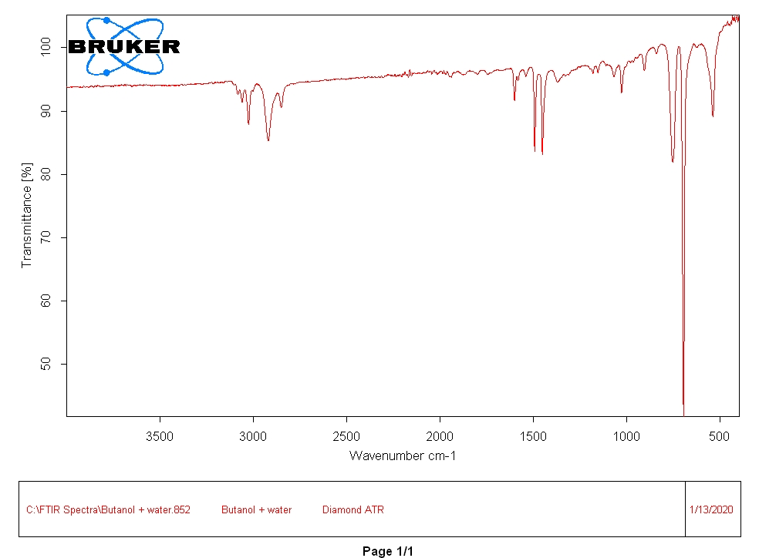
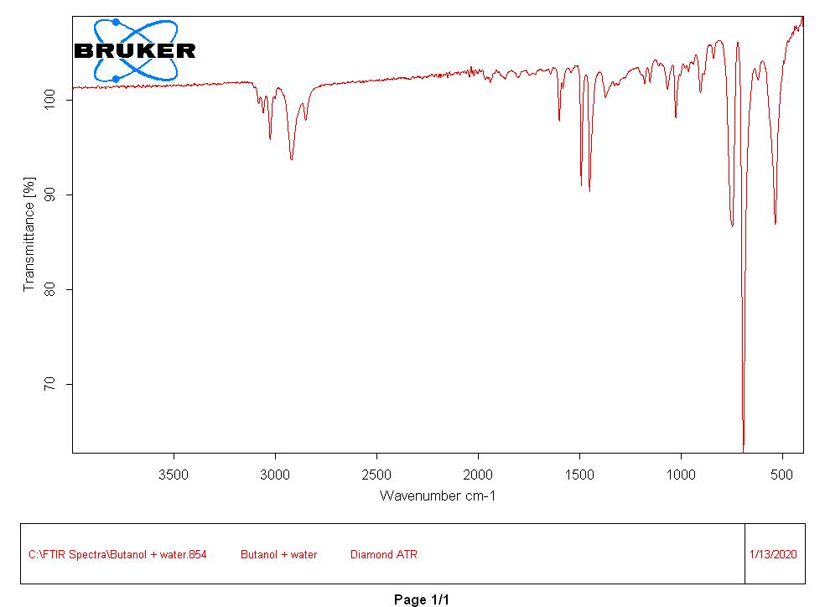
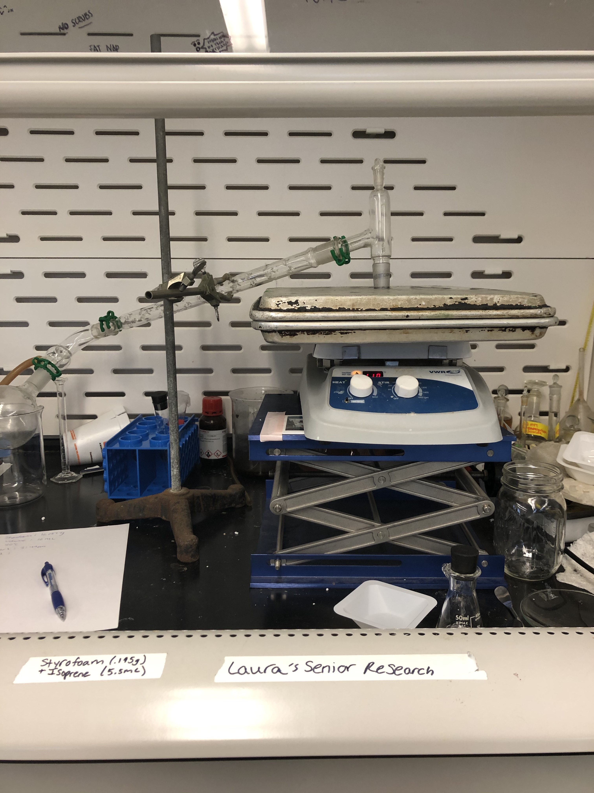
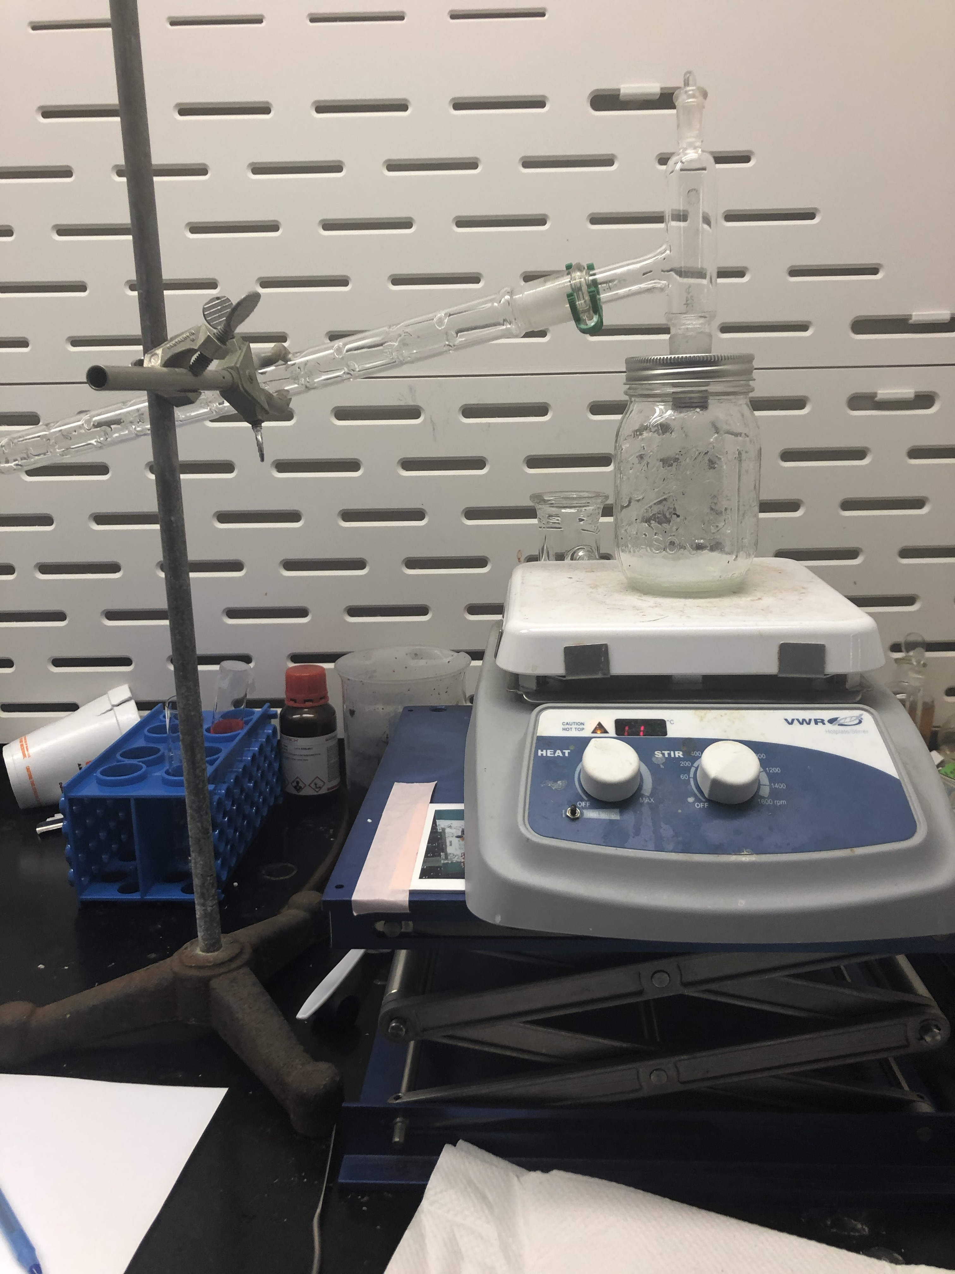
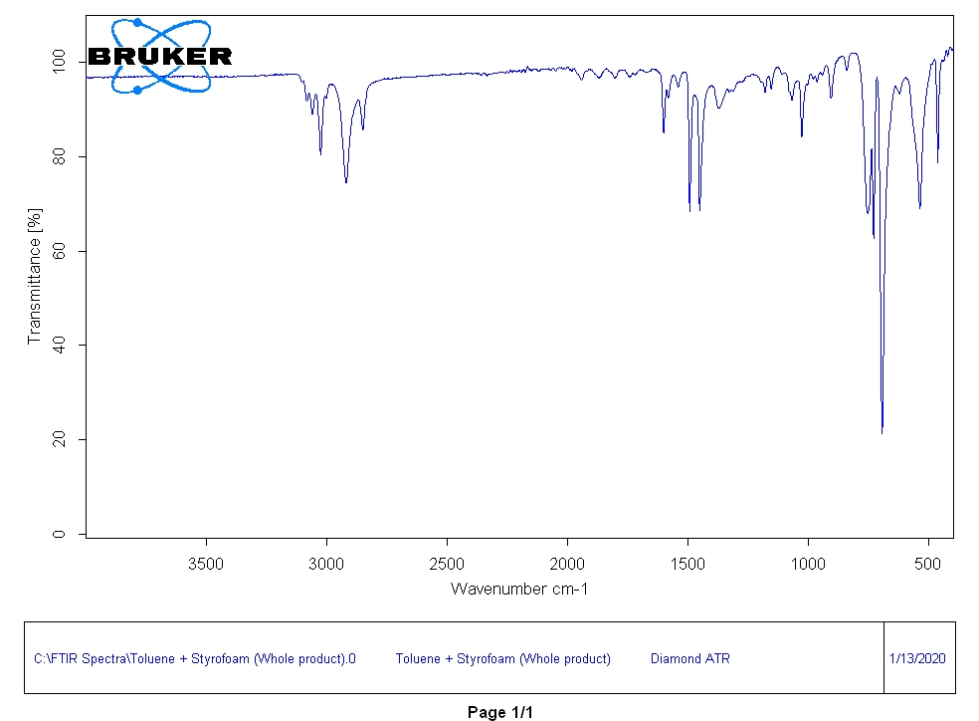
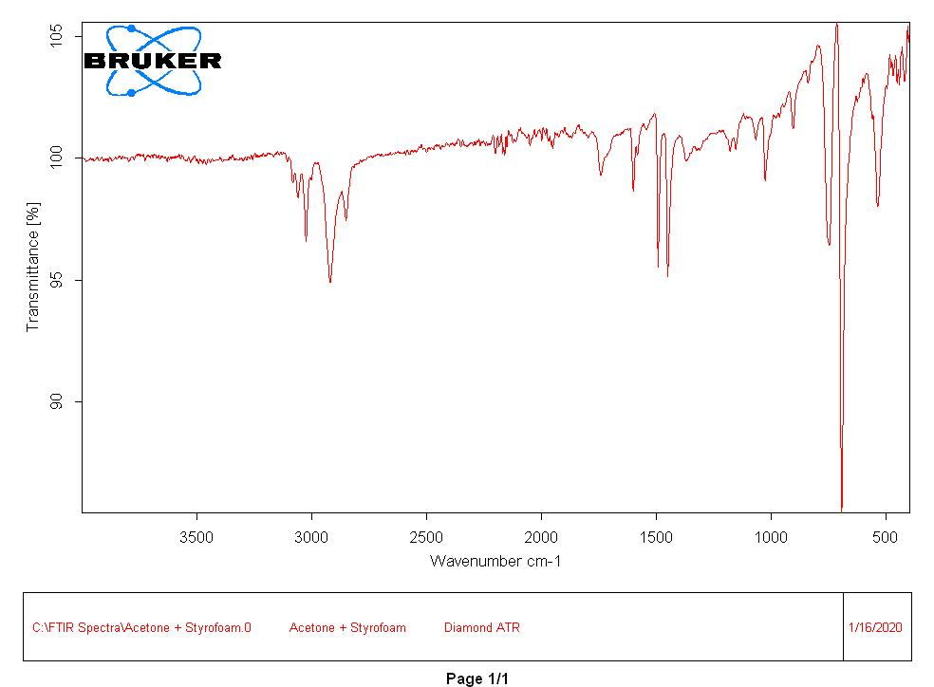
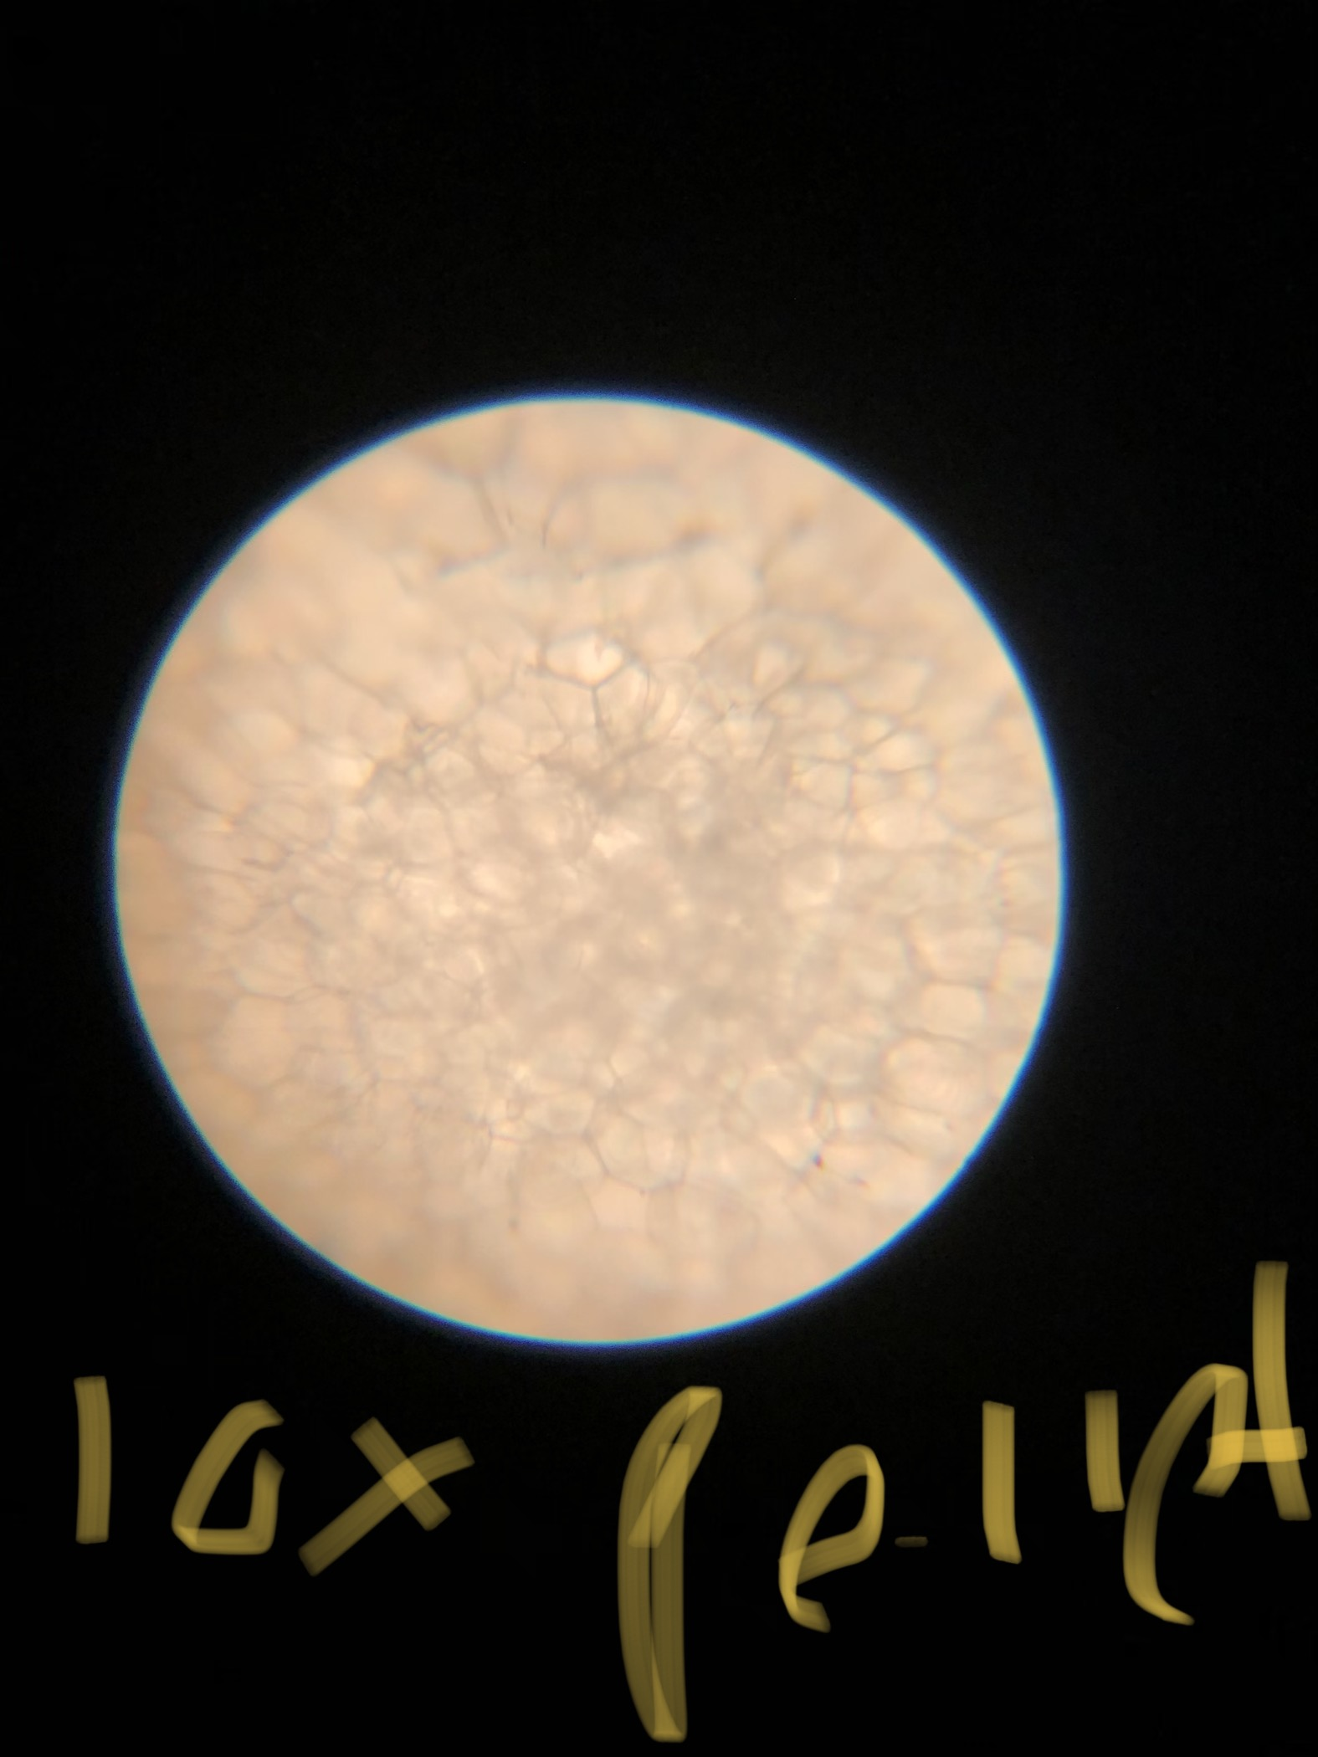
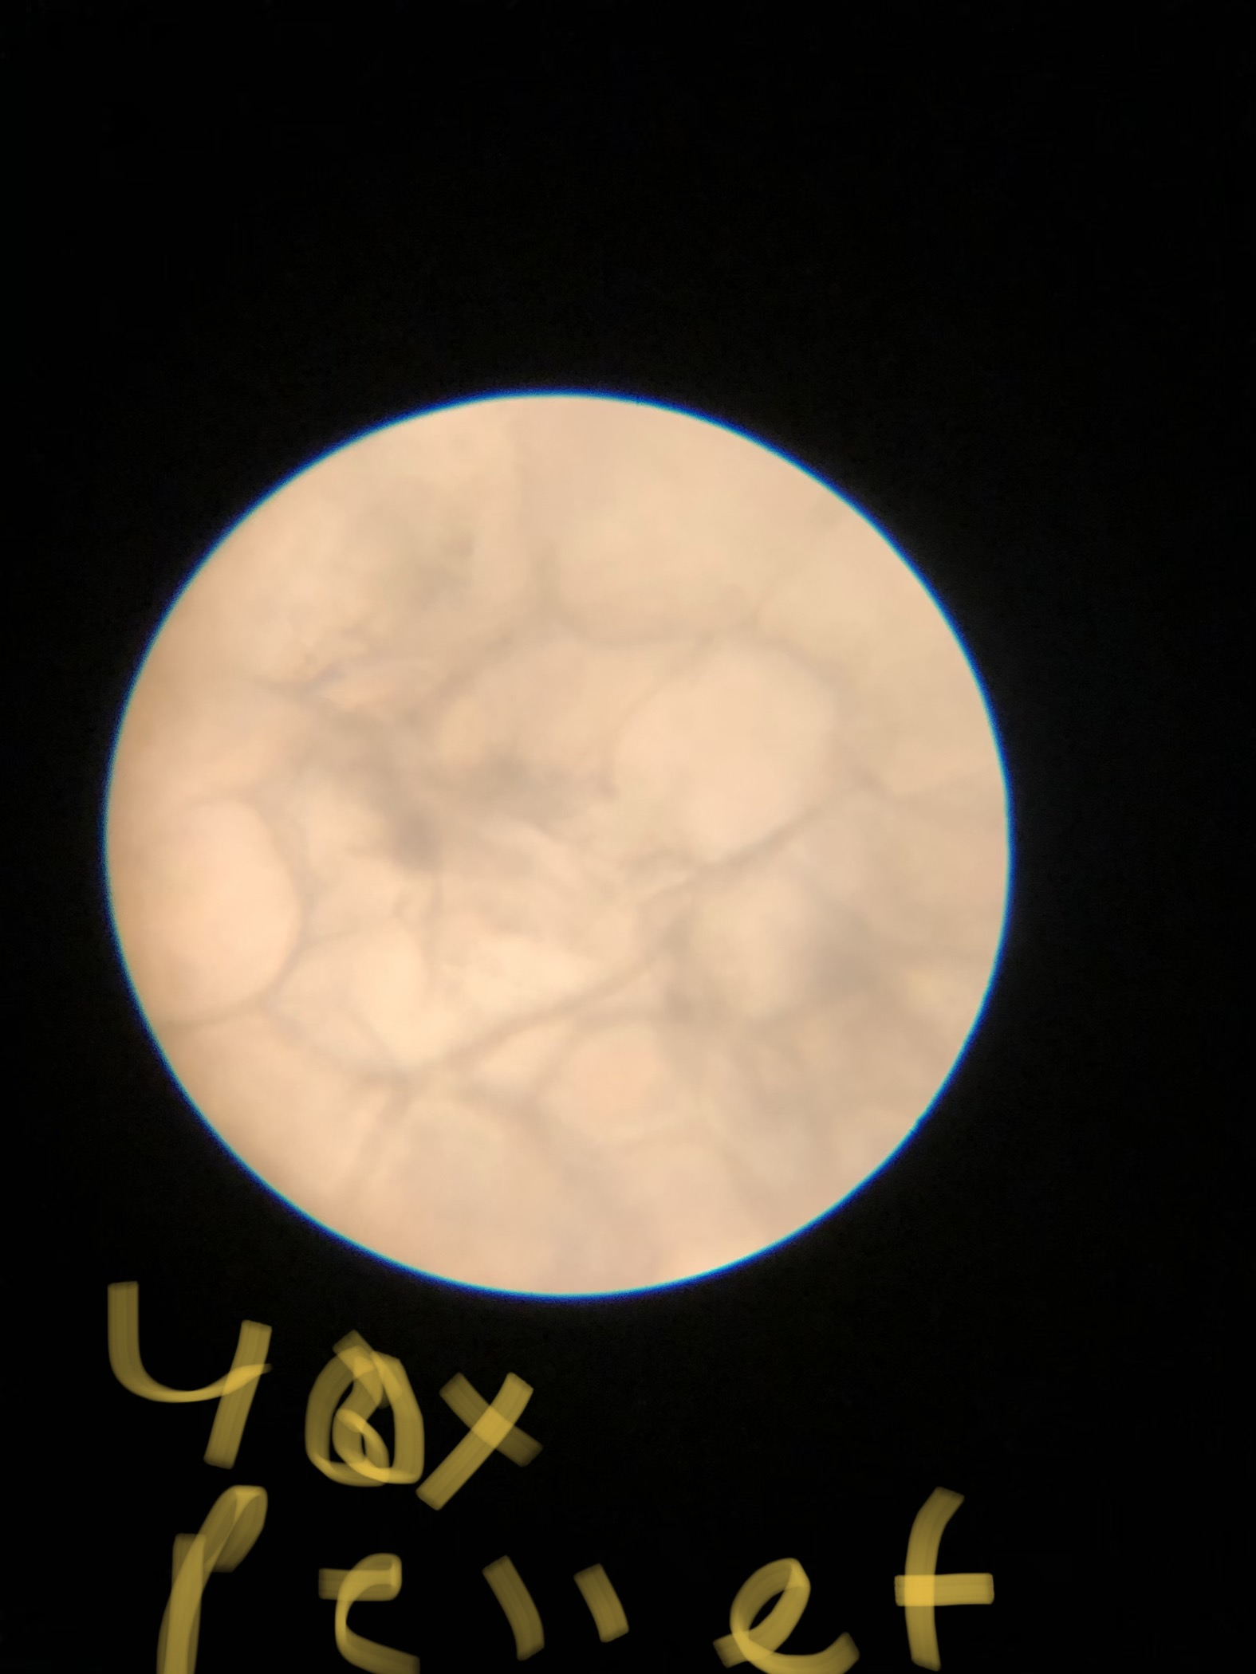
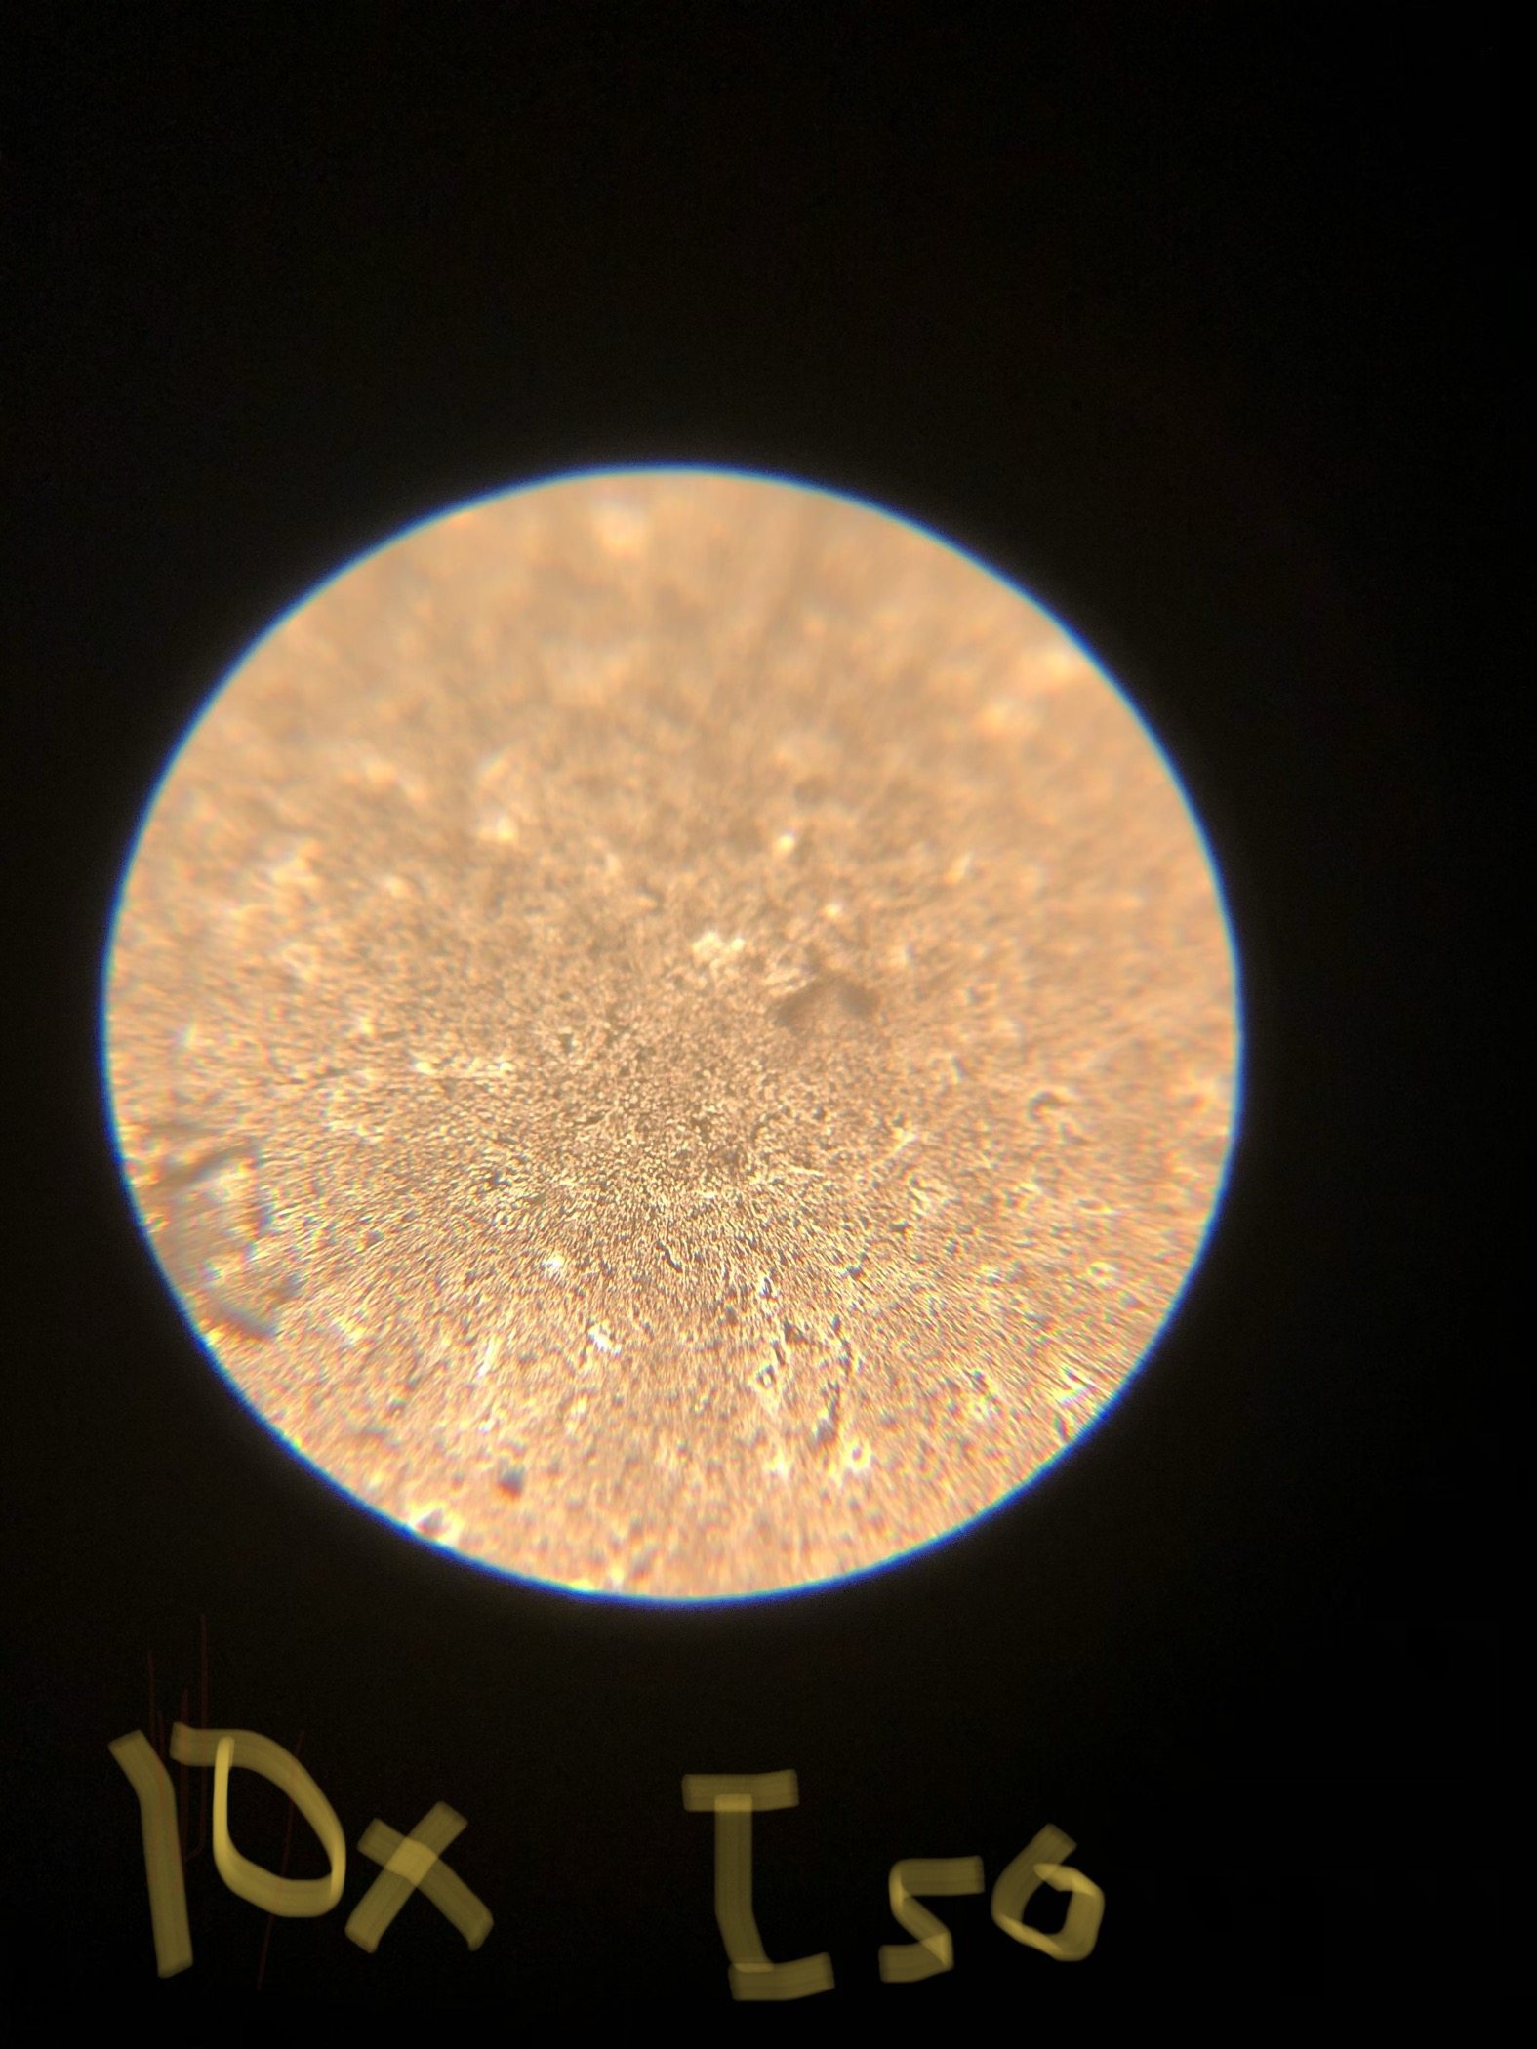
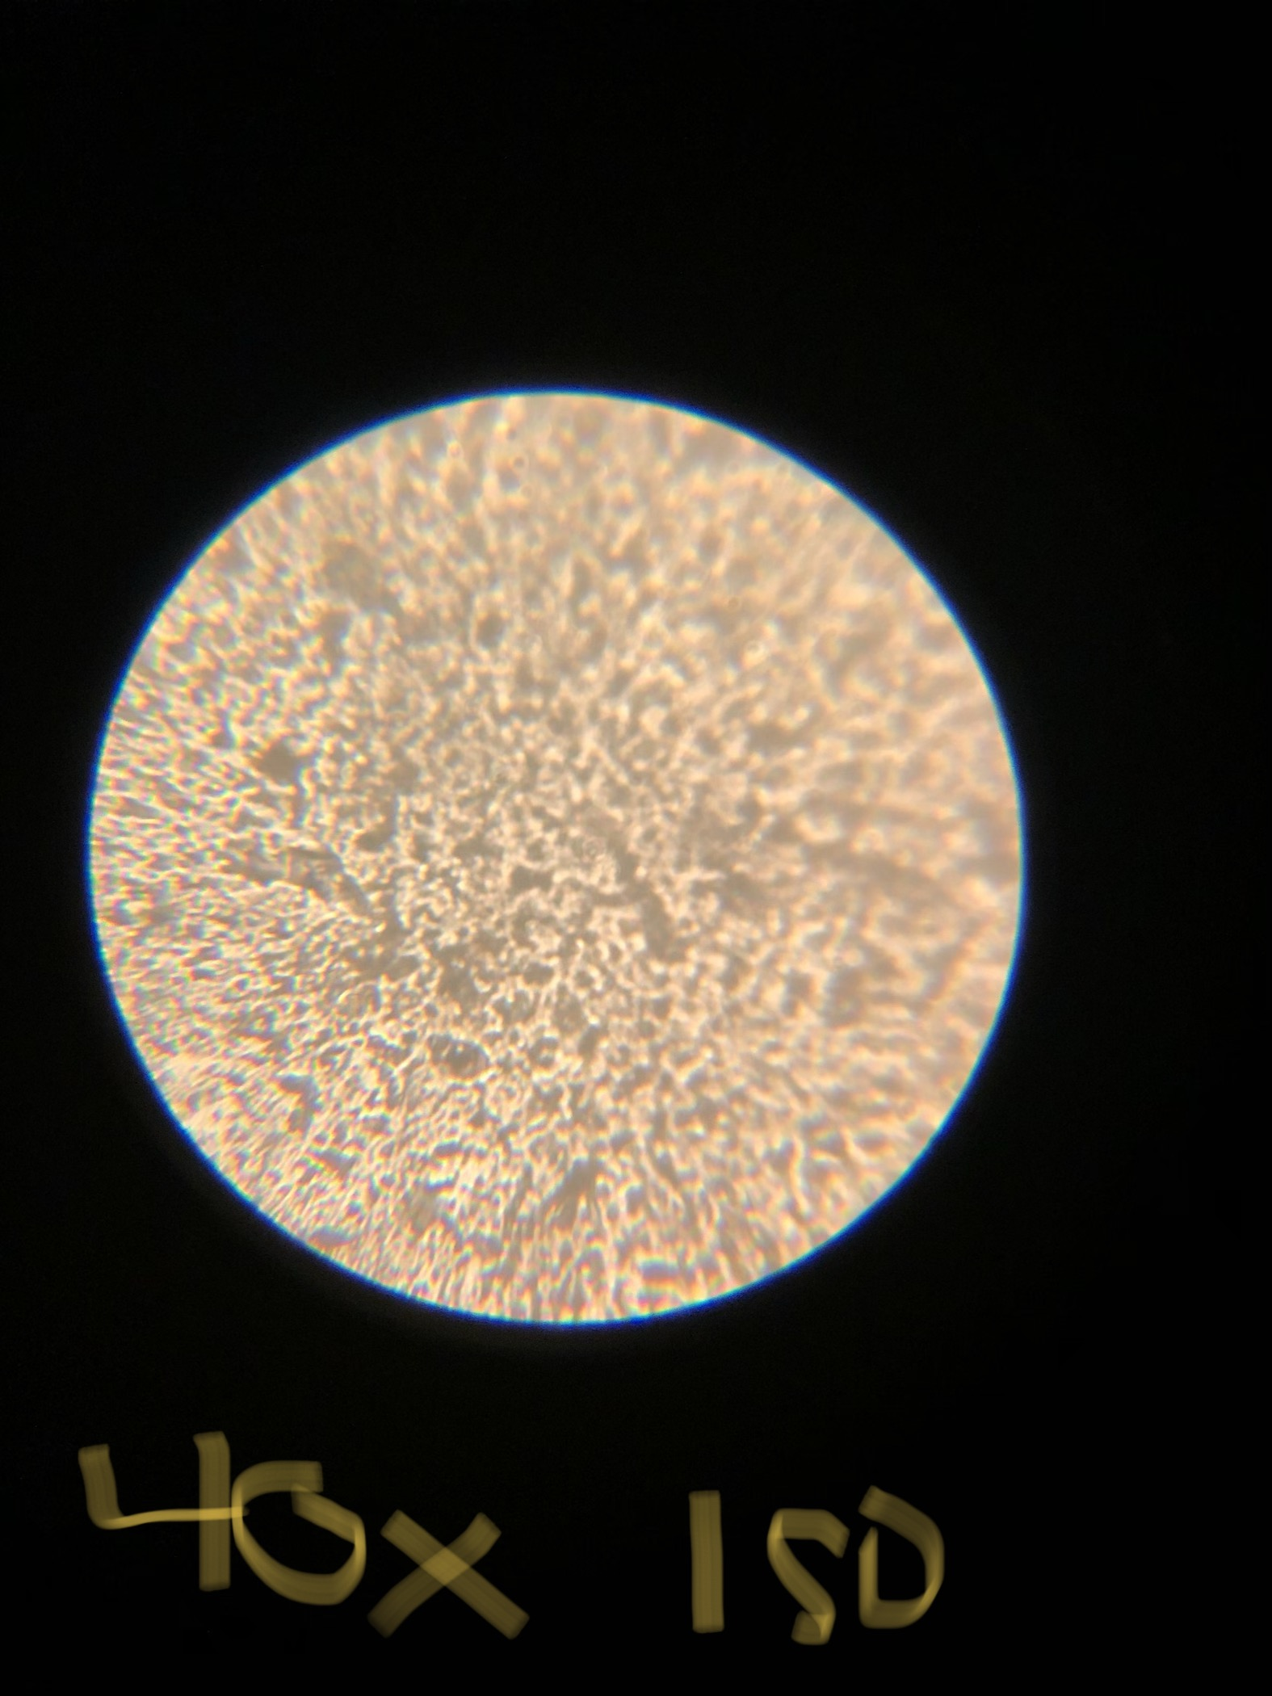
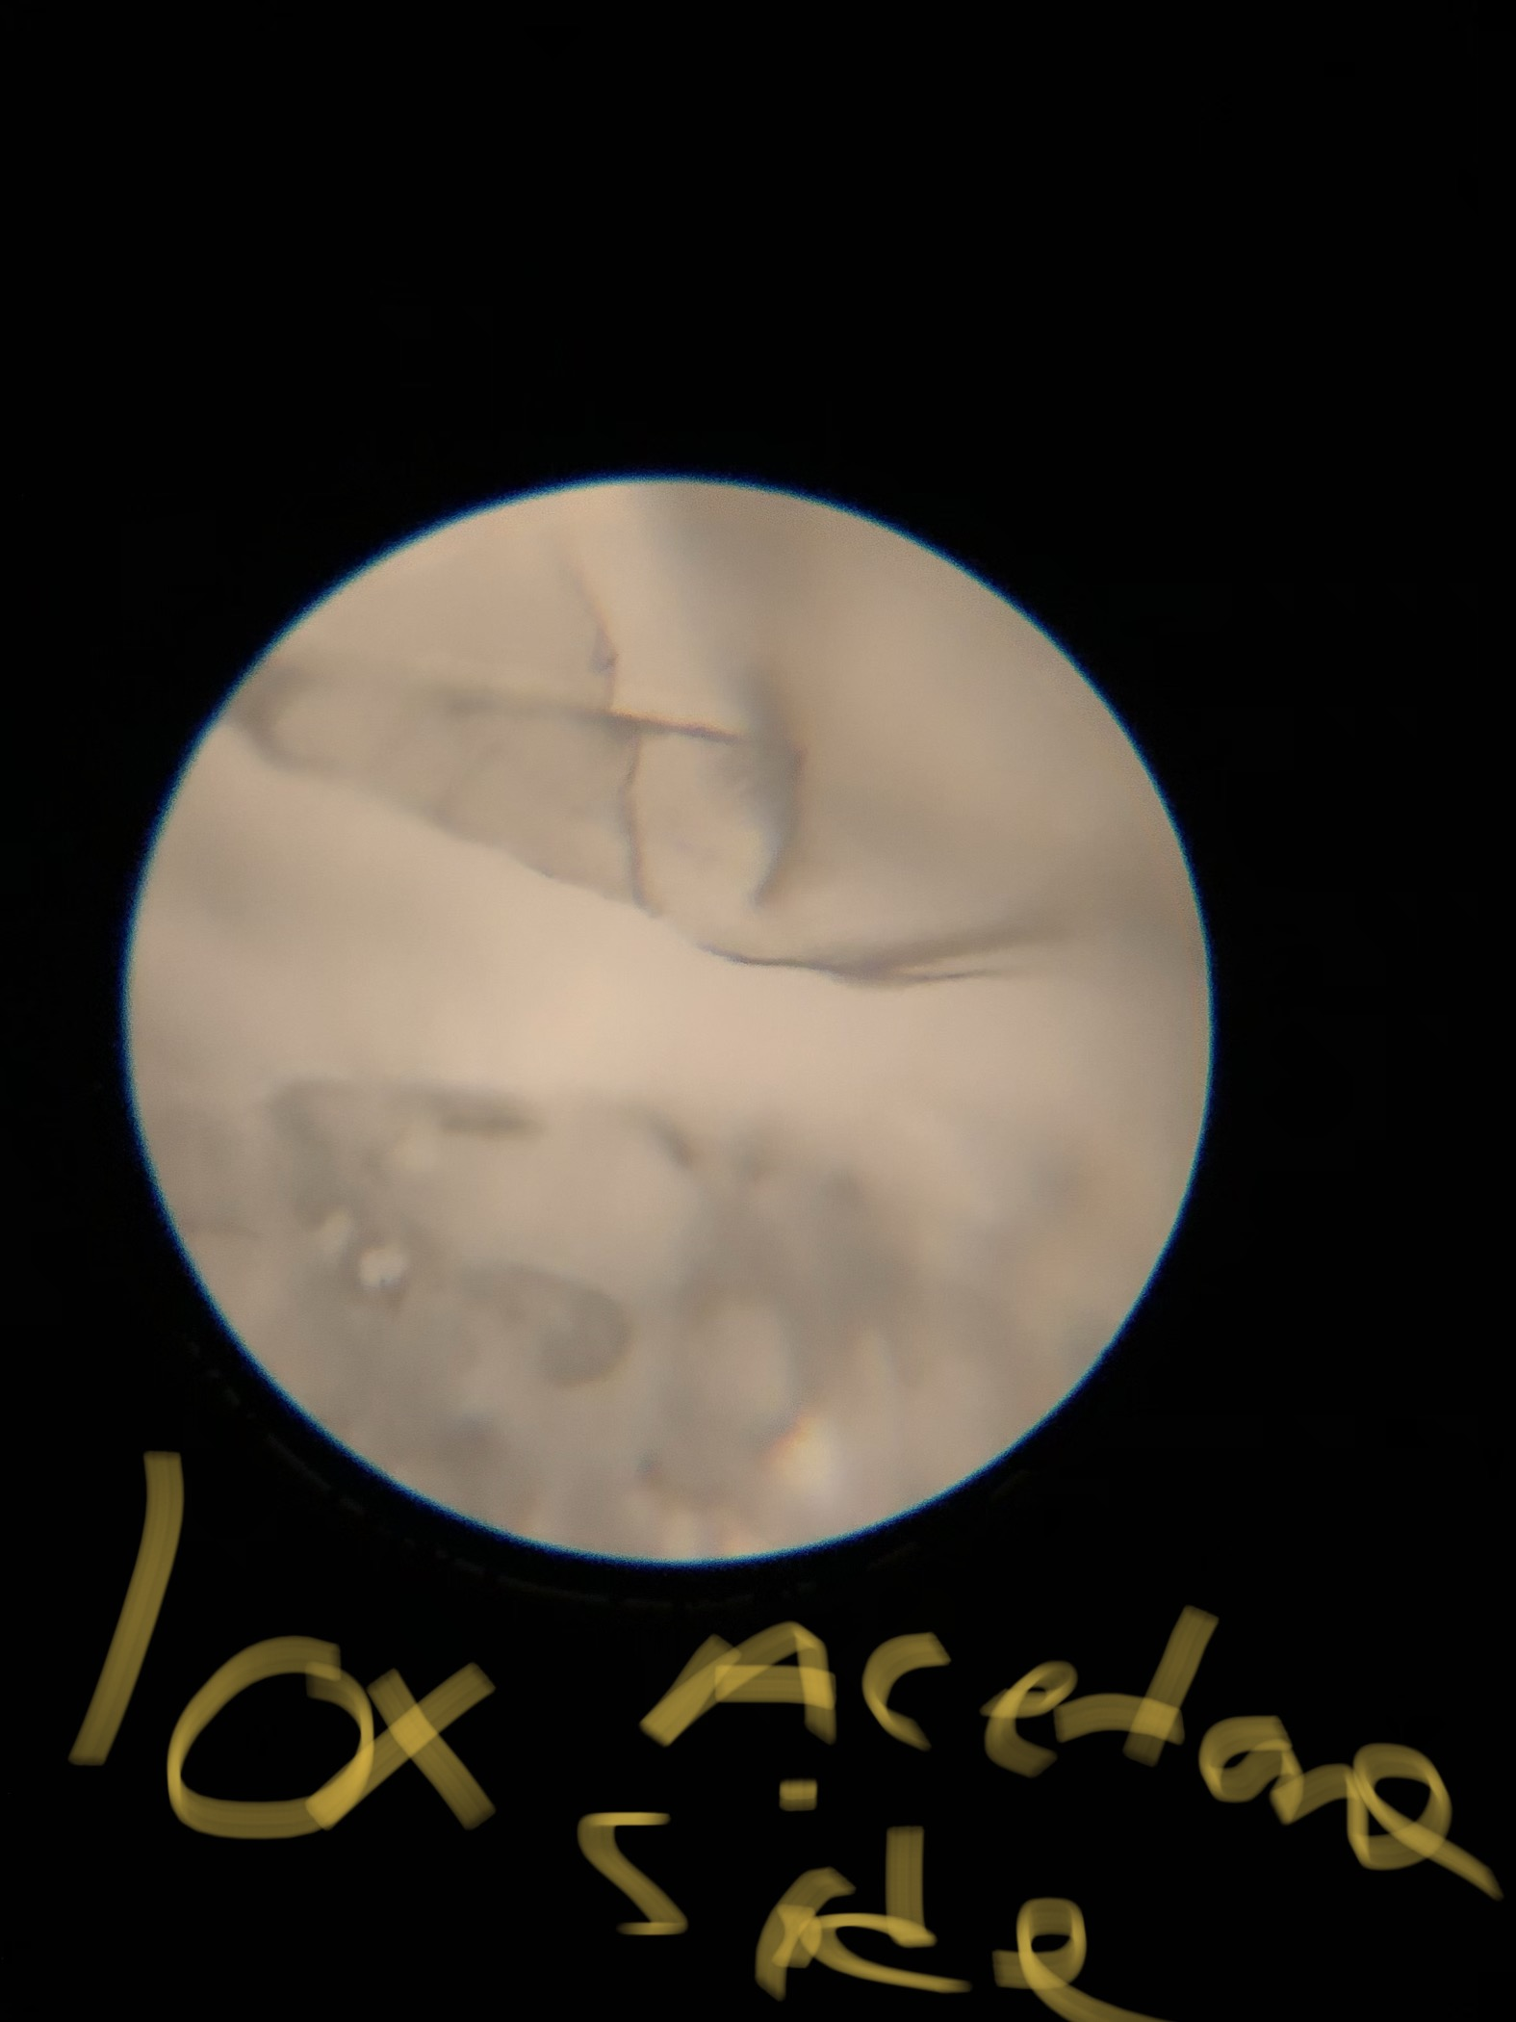
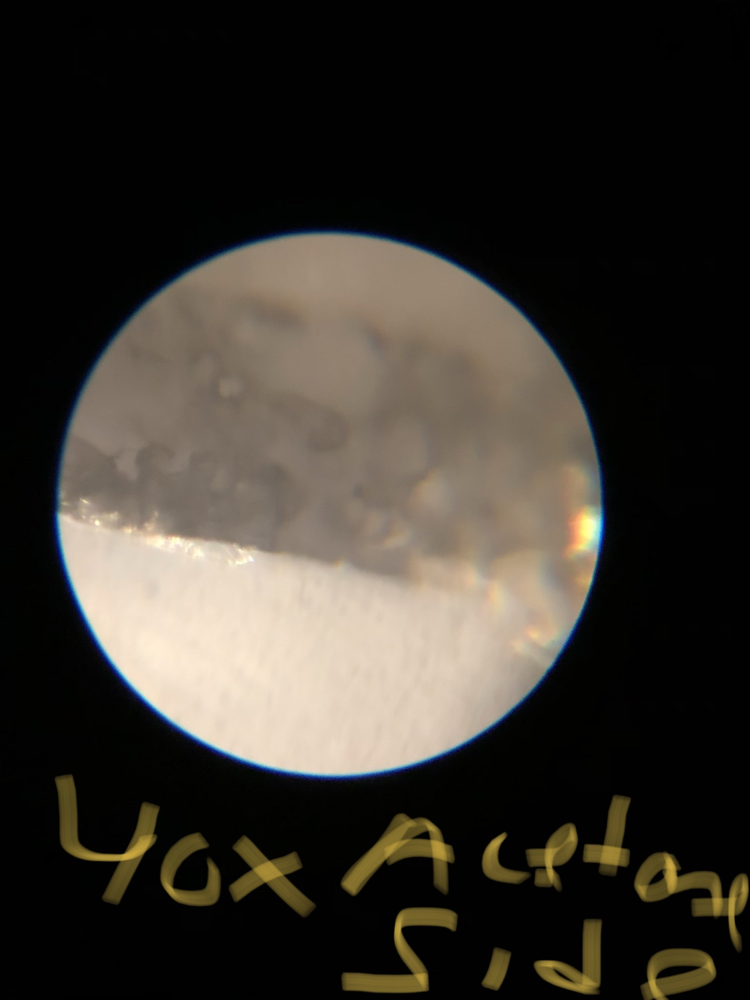
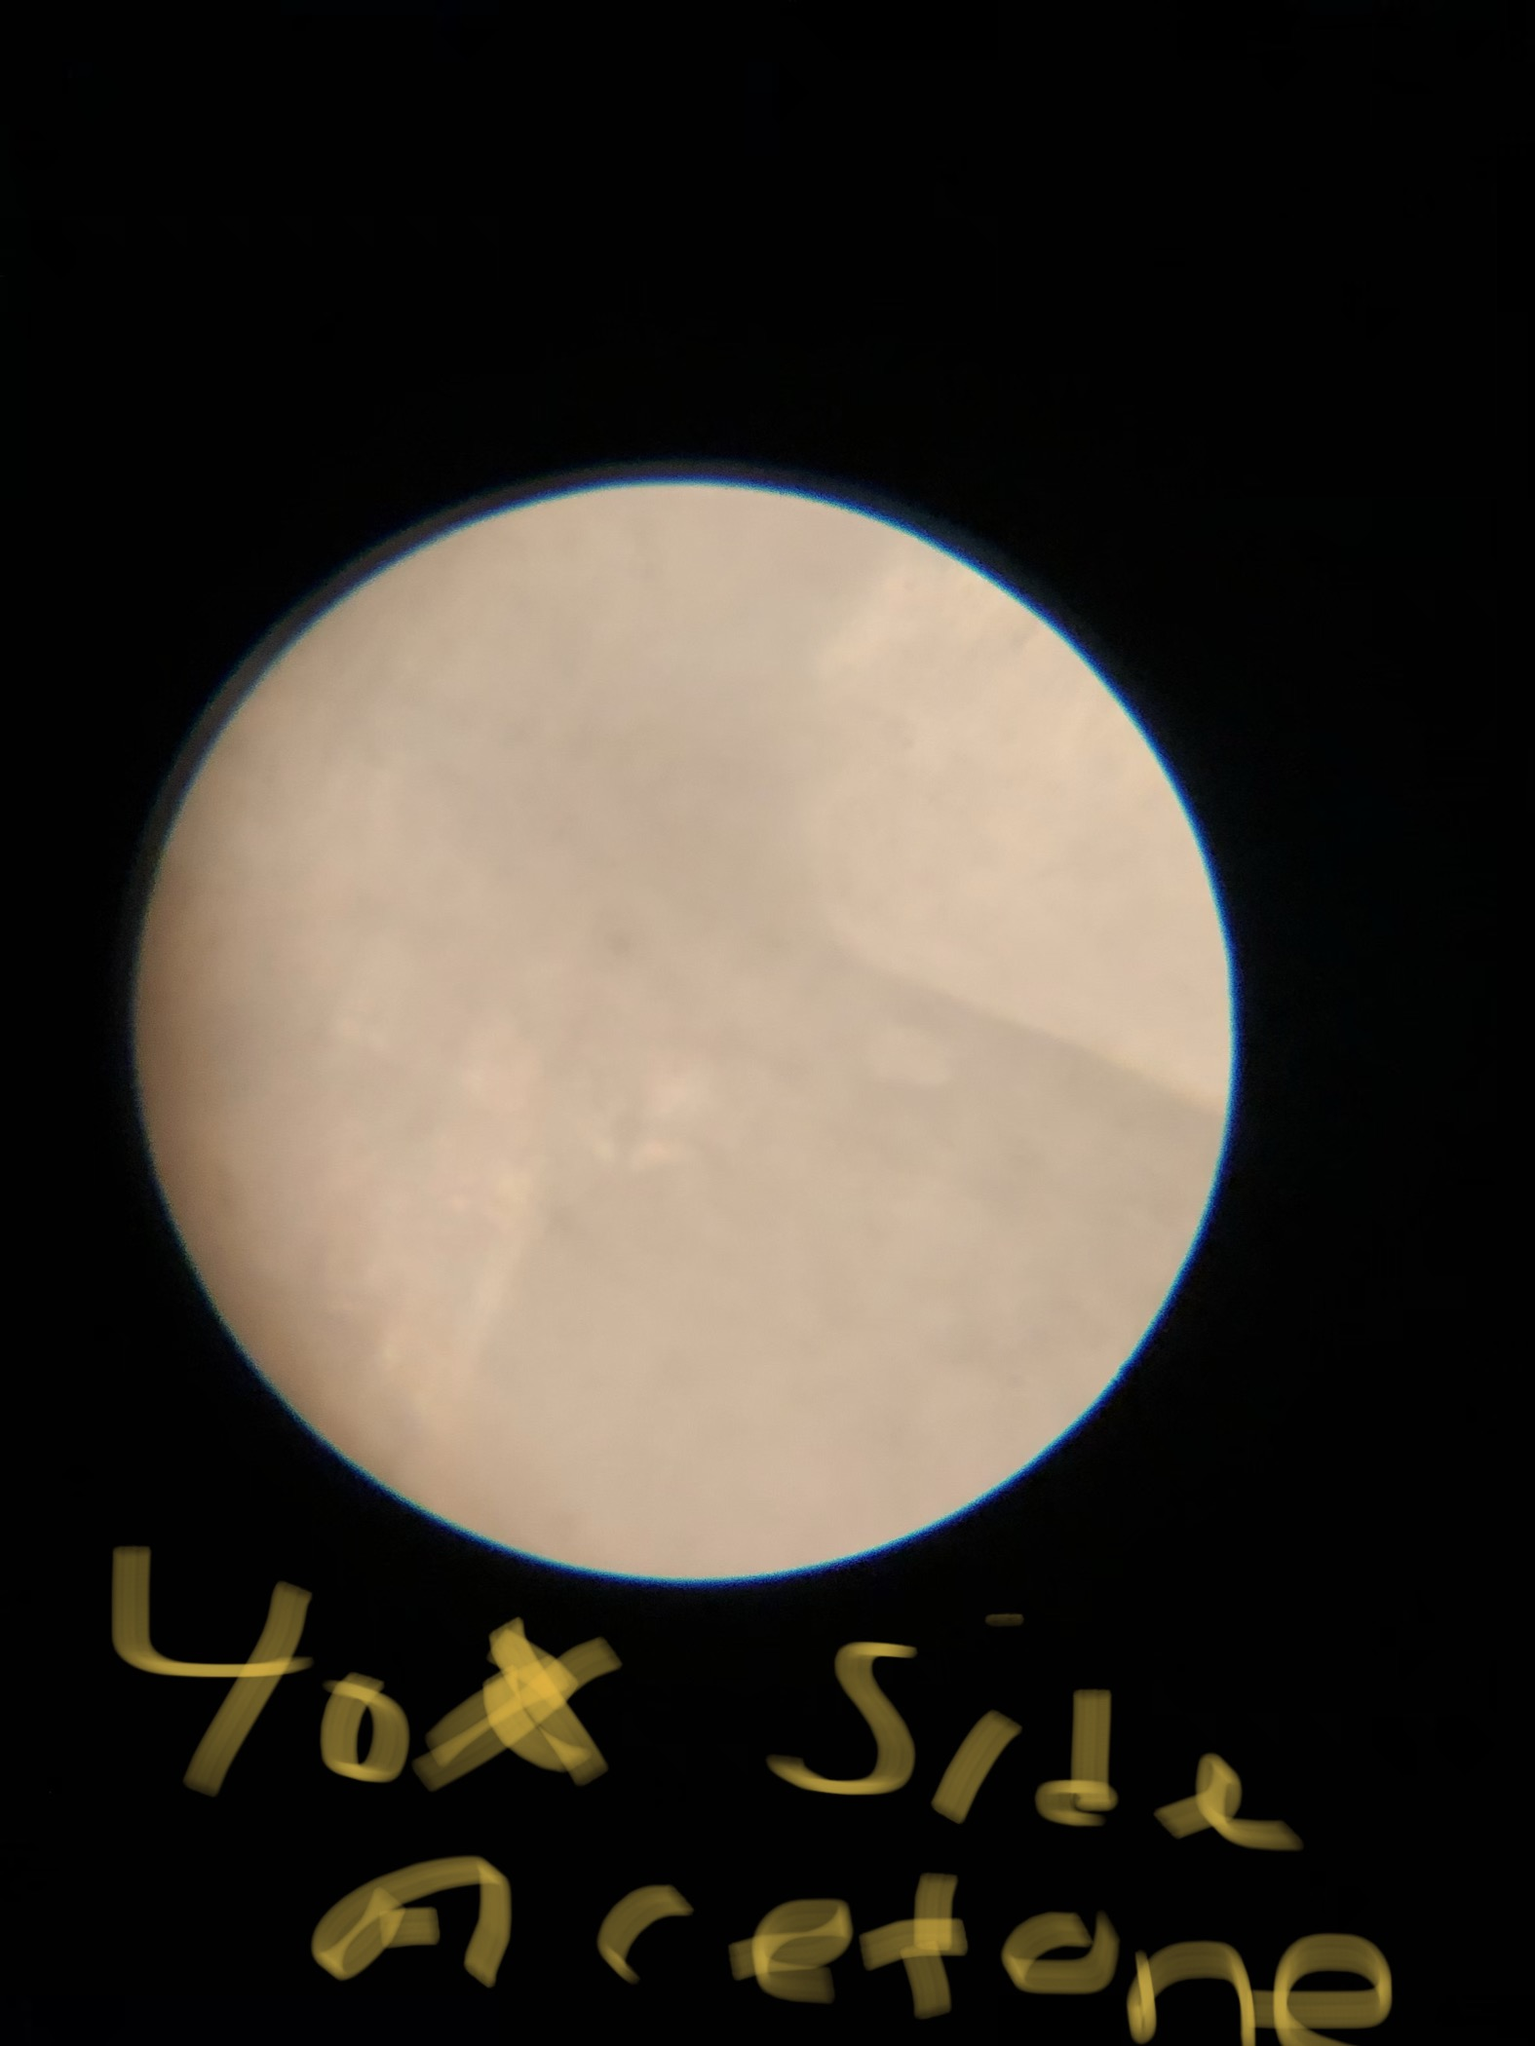
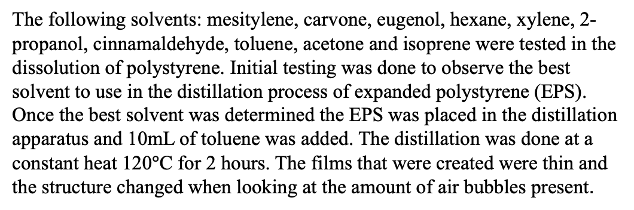
Solvent Based Recovery of Post Consumer Polystyrene for Interior Windows
Laura Bermol* , Tennyson Doane;
Department of Chemistry and Biology, Eastern Nazarene College, Quincy, MA
Abstract
Apparatus Design
IR Spectroscopy
Results Cont’d
The recycling process of polystyrene has been difficult, due to its harmful effects on environment and the economy. This work aims to create a recycling process that optimizes (a) transparency of the film, (b) a low boiling point solvent to minimize energy consumption, and (c) apparatus for the distillation process. In this work the distillation of polystyrene was tested in solvents before continuing the work with toluene. The experimental results for this work indicate that the toluene was the best when distilling polystyrene due to its properties and aiding in the glass-like transition of polystyrene.
The first apparatus used consisted of two baking sheets with a drilled hole in the top baking sheet for the condenser to go through. This prototype was inefficient in creating a vacuum seal when distilling and the distillation process was hard to see. The second apparatus was done in a smaller scale with a mason jar with a drilled hole in the lid. This created a vacuum seal and the process was seen easily.
Figure 11 : Styrofoam IR Spectra
Figure 12: Isoprene film IR Spectra
Aromatic
C-H
CH2
Aromatic
C-H
Figure 1: Cooking Sheets apparatus
Figure 2:Mason jar apparatus
Aromatic
C-H
C=C
Experimental
Aromatic C-H
C=C
The following solvents: mesitylene, carvone, eugenol, hexane, xylene, 2-propanol, cinnamaldehyde, toluene, acetone and isoprene were tested in the dissolution of polystyrene. Initial testing was done to observe the best solvent to use in the distillation process of expanded polystyrene (EPS). Once the best solvent was determined the EPS was placed in the distillation apparatus and 10mL of toluene was added. The distillation was done at a constant heat 120$°$C for 2 hours. The films that were created were thin and the structure changed when looking at the amount of air bubbles present.
Polystyrene
Isoprene
Figure 13: Toluene Film IR Spectra
Figure 14: Acetone Film IR Spectra
Microscopy
Table 1: Solvents tested in the distillation of polystyrene
Figure 3: Styrofoam (control) Figure 4: Styrofoam pellet (control)
Solvent | Boiling Point (°C) | Vaporization (kJ/mol) | C=C bonds | Aromatic | Soluble
Mesitylene | 164.7 | 38.7 | no | yes | yes
Toluene | 110.6 | 38.14 | no | yes | yes
Carvone | 231 | 42.89 | yes | yes | yes
Eugenol | 254 | 66.30 | yes | yes | yes
Hexane | 68 | 28.85 | no | no | no
Xylene | 140 | 42 | no | yes | yes
Acetone | 132.8 | 31.3 | no | no | yes
2-Propanol | 82.5 | 47 | no | no | yes
Cinnamaldehyde | 248 | 44.58 | yes | yes | yes
Isoprene | 34.07 | 26.8 | yes | no | yes
10x magnification
40x magnification
Aromatic
C-H
C-H
C-H Aromatic
C=C
Aromatic
C-H
Aromatic
C-H
C=C
Toluene
Acetone
*Acetone usually has a ketone that
shows major absorption of C=O at 1715
Figure 5: Isoprene Film Figure 6: Isoprene Film
10x magnification
40x magnification
Conclusions
The expanded polystyrene was distilled successfully, and films were made. The thickness of the films depends on the ratio of solvent and EPS. The more solvent the thinner the films become. The solvents that were tested were found to all dissolve the polystyrene except for the xylene. Isoprene showed the best results for transparent films, but due to isoprene becoming gaseous when in the distillation process was performed, toluene was chosen to finish the distillation process. Toluene was used to create the transparent films and was successful in the distillation process. The transparent sheets were clear and there were minimal air bubbles present. This procedure can be improved by finding the right solvent to polystyrene ratio.
Figure 7: Acetone Film Figure 8: Acetone Film Figure 9: Acetone film
10x magnification
40x magnification of edge
40x magnification
References
1.Adhikary, S., Rudzionis, Z., & Zubrus, M. Investigations of the Influence of Polystyrene
Foamed Granules on the Properties of Lightweight Concrete, Journal of Applied Engineering Sciences 2019, 9(1), 19-24.
2. Chen, B.; Liu, J.; Chen, L.Z. Experimental Study of Lightweight Expanded Polystyrene
Aggregate Concrete Containing Silica Fume and Polypropylene Fibers. J. Shanghai Jiaotong Univ. Sci. 2010, 15, 129–137.
3.María Teresa García, Ignacio Gracia, Gema Duque, Antonio de Lucas, Juan Francisco
Rodríguez. Study of the solubility and stability of polystyrene wastes in dissolution recycling, Waste Management 2009, 1814-1818.
I⁻
Contact Information: Laura.I.Bermol-Diaz@enc.edu, 508-617-7088

