Slide 1
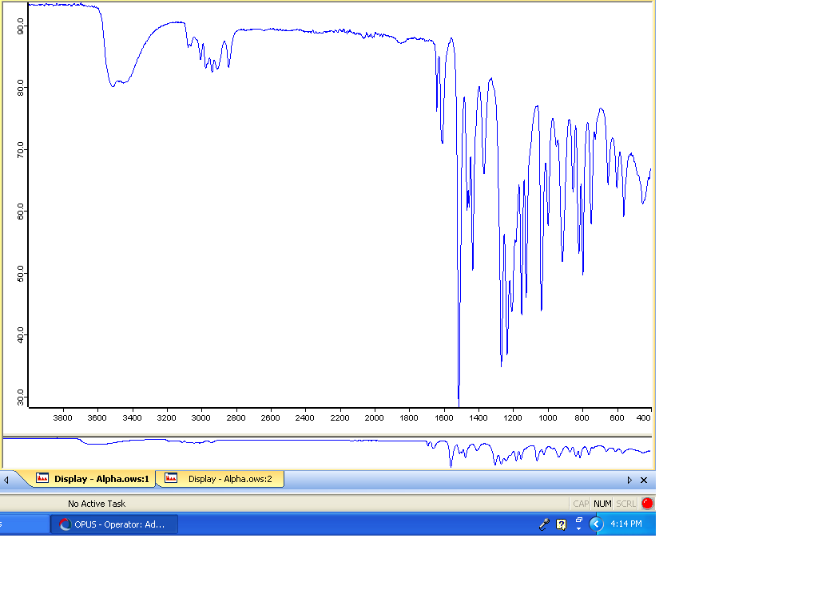
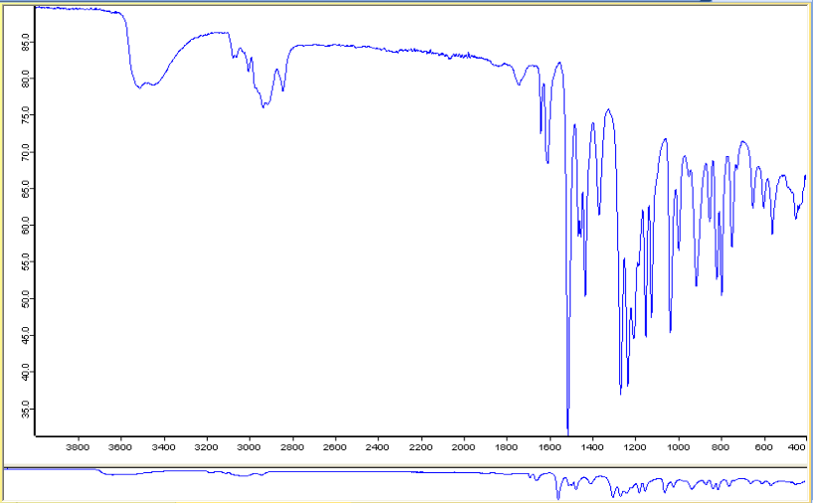
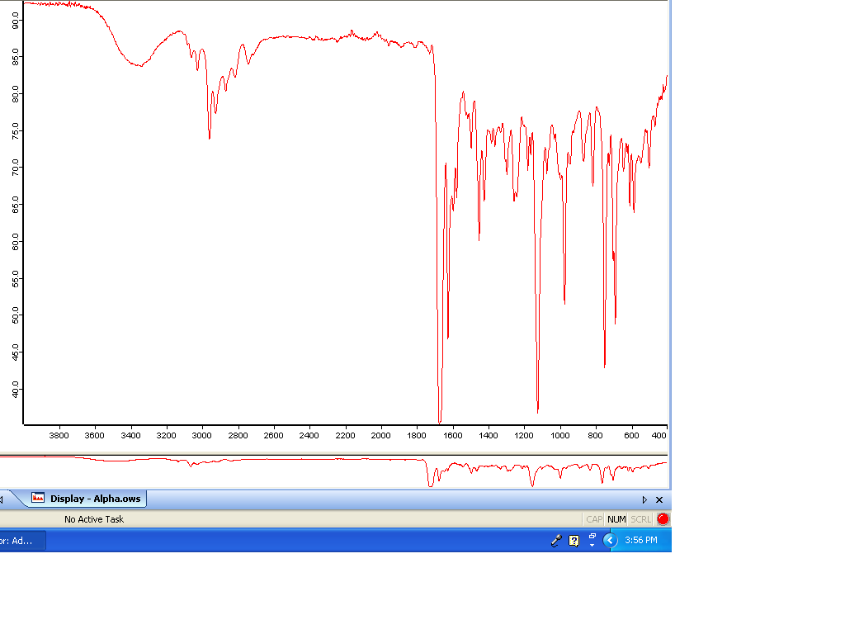
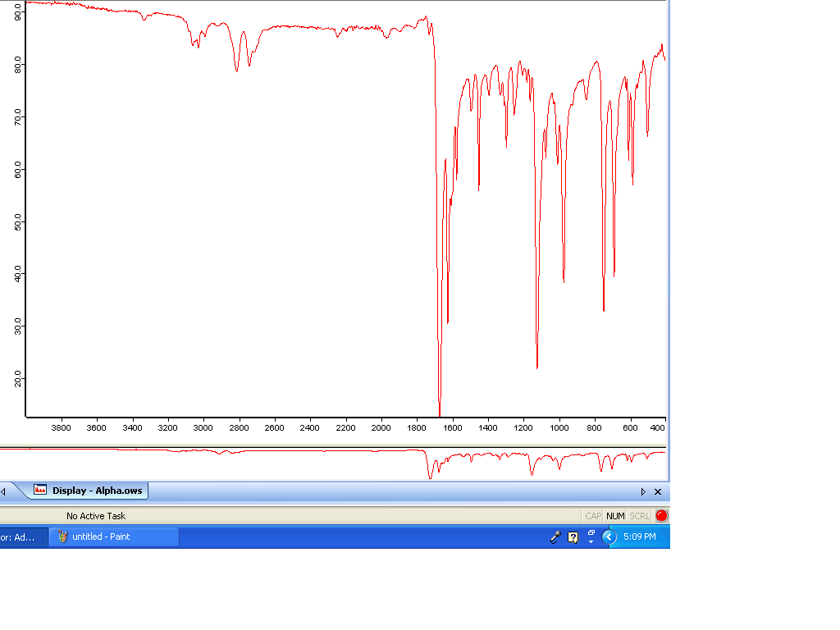
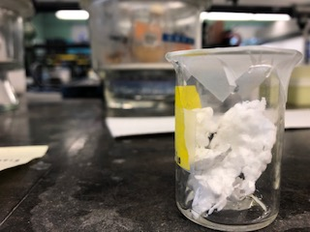
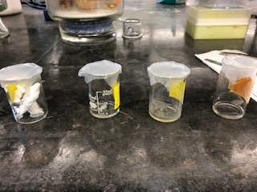
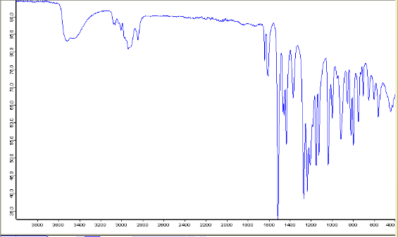
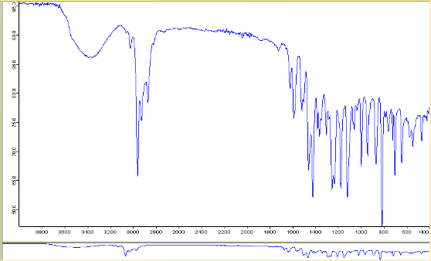
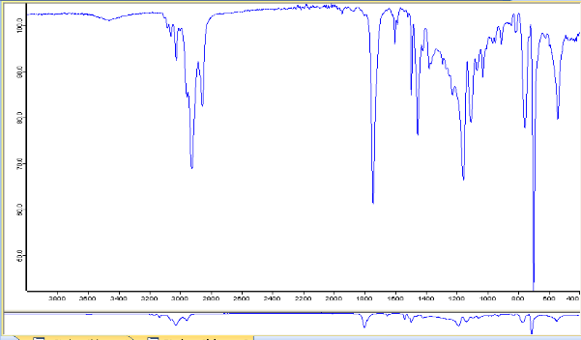
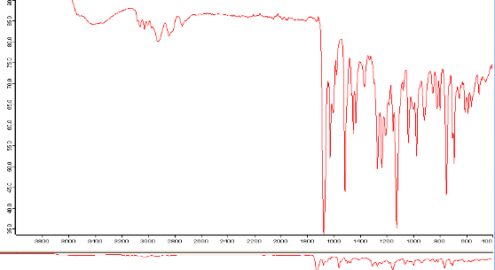
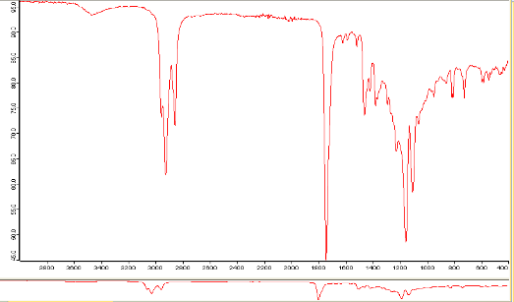
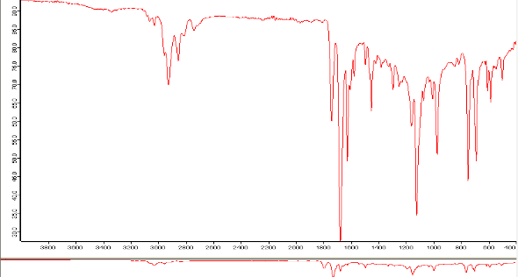
Dissolution of Polystyrene in Essential Oils
Jameela Chapman
Eastern Nazarene College
INTRODUCTION
The methods of this experiment involved weighing 1 gram of polystyrene and adding a quantity of essential oil to the polystyrene and parafilm on the container. Three trials were conducted during this experiment—one using 1 mL of each oil or compound with polystyrene, then using a 50/50 mixture of cinnamaldehyde, a known accelerant of the dissolution reaction, and each essential oil.
The procedure was modified to add a trial of dissolution with a 50/50 mixture of thyme oil and the other essential oils, including cinnamaldehyde. he time of initial decomposition was monitored over the span of 10 minutes. The decomposition rate was then measured over the span of 7 days and 14 days, respectively.
Infrared spectroscopy was used to analyze the dissolution reaction at 7 and 14 days. In infrared spectroscopy, the presence of essential oils are indicated by a carboxylic alcohol group, an aldehyde group, an aromatic and/or an alkene group. Infrared spectroscopy of each essential oil was taken prior to and after the addition of polystyrene.
CONCLUSION
14C Polystyrene, better known as Styrofoam, is a plastic polymer that is used to make food containers and various forms of package material. Its chemical composition involves the use of Concern has arisen over the past few years about the amount of Styrofoam being mass produced. Over time, it has shown to be damaging to human health and the environment. The use of Styrofoam products to contain or heat foods contribute to human ingestion of microplastics. Microplastic ingestion has been linked to health issues like organ inflammation, liver damage and blood clots in humans. This research examines the capability of common oils produced in the seasoning of food may contribute to human microplastic ingestion. The presence of polystyrene was indicated by a C-H stretching peak and aromatic C=C stretching peak.
OBJECTIVES
The objective of this research is to examine the rate in which polystyrene is dissolved 3 in different essential oils: clove oil, oregano oil, and thyme oil.. I will then examine the dissolution reaction on an infrared spectra to determine whether the oil can exhibit full dissolution over time or result in the production of microplastic. I will also attempt to alter the dissolution rate of polystyrene in each essential oil through use of cinnamaldehyde, a known catalyst of polystyrene dissolution.
To accomplish this, I will analyze the visual dissolution rate of polystyrene in each essential oil over the course of two weeks, using the chemical compound eugenol as a control.
I hypothesize that the clove oil will dissolve polystyrene the most quickly, but also demonstrate the highest capacity for microplastic production.
MATERIALS AND METHODS
In infrared spectra with the addition of polystyrene to thyme oil, the components of thyme oil all remained present with the components of the polystyrene, but the alcohol/phenol group was residual. This indicates that dissolution may have occurred, but not at a significant rate. When paired with cinnamaldehyde, the alcohol/phenol group disappeared, and only interactions between the cinnamaldehyde and polystyrene were shown. This corroborates that thyme oil does not serve as a good solvent for polystyrene, but when paired with an accelerant, dissolution can still occur.
As expected, clove oil and eugenol dissolved polystyrene at the quickest rate. Infrared spectra with the heterogenous mixture displayed a distinct phenol group and aldehyde group. Indications of polystyrene were difficult to determine on Infrared Spectra. This could indicate that the solvent composed of cinnamaldehyde and clove oil was very strong and may have caused a decomposition reaction.
In conclusion, polystyrene does undergo a dissolution reaction with each essential oil; however, the chemical components do not appear to be drastically altered. This may be a contributing factor the production of microplastics. The polystyrene and thyme oil mixture had the most perceivable isolation of compounds, as groups that are present in both components show up on the combined scans. Cinnamaldehyde does speed up the dissolution rate; however, there is still no drastic alterations to the compounds present in each oil.
Further research on the level of microplastics produced in each reaction via microscopy would be beneficial for learning how the dissolution of polystyrene in each oil would ultimately affect the amount of microplastics produced. Other methods, like diffusion of the oils rather than direct contact of polystyrene with the oil, may expand on this research.
Figure 3: Eugenol Infrared Spectra. Denoted by an alcohol (O-H) stretch around 3500 cm⁻¹, a variety of alkane (-CH3) groups from 3000-2800 cm⁻¹, and a C=C aromatic peak near 1550 cm⁻¹.
Figure 4: Clove Oil Infrared Spectra. Denoted by an O-H (phenol) group at 3200-3600 cm⁻¹, a C-H group at 2900 cm⁻¹, an aromatic at 1600 cm⁻¹, an alkene (C=C) around 1550 cm⁻¹, an ether at 1100 cm⁻¹.
Figure 5: Oregano Oil Infrared Spectra. Denoted by an alkane stretching vibration at approximately 2960 cm⁻¹, antisymmetric alkane –CH3 bending at 1420 cm⁻¹ and C-O-C stretching at approximately 1249 cm⁻¹.
REFERENCES
Figure 6: Thyme Oil Infrared Spectra. CHx deformation (3150-3050 cm⁻¹) that corresponds to a C-H (aromatic) stretching group, and a stretching alcohol/phenol O-H at absorption 3550-3200 cm⁻¹
Figure 7: Cinnamaldehyde Infrared Spectra. Possesses aldehyde groups and strong polarity, which makes it compatible with the alkene groups in polystyrene.
Fang J F, Xuan Y M, Li Q. Preparation of polystyrene spheres in different particle sizes and assembly of the PS colloidal crystals. Sci China Tech Sci, 2010, 53: 3088−3093, doi: 10.1007/s11431-010-4110-5
Bakir A, Rowland SJ, Thompson RC (2014) Enhanced desorption of persistent organic pollutants from microplastics under simulated physiological conditions. Environ Pollut 185:16– 23
B.A. Miller-Chou, J.L. Koenig / Prog. Polym. Sci. 28 (2003) 1223–1270
Boughenjioua H, Djeddie S, Seridi R. A complementary analysis of thyme essential oil by fourier transformaed inreared spectroscopy. Int. J. Chem. Sci, 2017, 1: 29-32.
Matéria (Rio J.) vol.24 no.3 Rio de Janeiro 2019
RESULTS
After watching the dissolution rate of each oil over the span of 30 minutes, Clove oil and Eugenol completely dissolved polystyrene. Oregano oil partially dissolved the polystyrene, and the thyme oil did not undergo dissolution over the 30- minute timespan. Over the span of 1 week, clove oil, eugenol and oregano oil completely dissolved the polystyrene. Thyme oil was the least inclined to dissolve polystyrene, as it appeared to be lightly absorbed by the polystyrene, but the polystyrene retained its shape and appearance.
Cinnamaldehyde visibly increased the dissolution rate of all essential oils. After 30 minutes, all oils with the addition of cinnamaldehyde completely dissolved polystyrene.
The CHx deformation peak typically present in Thyme oil was still present after the addition of polystyrene; this may contribute to its incompatibility with polystyrene as a solvent. Oregano oil was the second least inclined to dissolve polystyrene. The strong alkene groups present in Oregano appear weaker after the addition of polystyrene, indicative of a dissolution reaction.
After infrared spectroscopy, the resulting compounds still expressed the same chemical groups as the isolated compounds, which can be indicative of dissolution but no significant chemical alteration.
ACKNOWLEDGEMENTS
Figure 1: Thyme oil with polystyrene after 15 minutes of dissolution. Monitored to test the rate in which microplastics were found.
Figure 2: Eugenol and Clove Oil with Polystyrene after 30 minutes. Polystyrene dissolved first in the eugenol (after 15 minutes), and then in the clove oil (after approximately 18 minutes).
Figure 10. Oregano Oil with Polystyrene Infrared Spectra (14 days). Alkane stretching vibration at approximately 2960 cm⁻¹, paired with prominent stretching C=C peaks of polystyrene.
I would like to acknowledge Eastern Nazarene College for the use of their laboratories for research.
Figure 9. Clove Oil with Polystyrene Infrared Spectra (14 days). Alcohol/phenol group of clove oil is prominent, as is the alkane; indication of polystyrene is difficult to determine from the scan.
Figure 11. Thyme oil with Polystyrene Infrared spectra. Small alcohol/phenol peak and CHx deformation are visible; characteristics of polystyrene are difficult to decipher.
Figure 12: Eugenol with Polystyrene Infrared Spectra (14 days). Characteristic OH peak in eugenol still present with stretching C=C peaks of polystyrene.
Figure 13. Clove oil, Cinnamaldehyde, and Polystyrene Infrared Spectra. Alcohol/phenol group of the oil is prominent; significant alteration of alkane groups. No indication of C=C stretch for cinnamaldehyde.
Figure 14. Oregano oil, Cinnamaldehyde, and Polystyrene. OH peak of Oregano oil diminished; stretching C=C peaks indicative of polystyrene or cinnamaldehyde.
Figure 15. Thyme oil, Cinnamaldehyde and Polystyrene. Alcohol phenol peak is residual with strong aldehyde groups indicative of the presence of cinnamaldehyde.

