Slide 1
Plant Growth station: Aiding the Average Person in Becoming a Better Gardener.
John U Free seminar series, 2020
José Mata
Candidate, bachelor of science in Electrical Engineering
Candidate, Bachelor of arts in business administration
Sponsored by the science & technology division

Slide 2
Problem
The average person does not have gardening experience.
Different plants have different ideal conditions for their growth and development.
Even when these conditions are known, it is difficult to ensure that the plant remains in them.

Slide 3
How the Plant Growth station addresses the problem
Lets users know the temperature, air humidity, and light level of their plant.
Near real-time data display online so the user is always aware of their plants’ conditions.
Email service further helps the user stay on top of monitoring the plant.

Slide 4
Main Purpose of the PGS
The main purpose of the Plant Growth Station is to aid customers in the process of growing their own plants by providing a way to monitor the plant’s conditions online.

Slide 5
Customers
The expected customers that the PGS will serve include everybody from the young adult demographic to elders who is interested in growing plants.
No previous experience is required by the user in plant growth for them to see the benefits of the Plant Growth Station.

Slide 6
System requirements
The system shall [1] provide a container in which the user can grow a plant.
The system shall [2] be powered from a wall outlet, with the standard 120V and 60Hz frequency output.
The system shall [3] display the temperature, humidity, and light level values measured online for the user’s access.
The system shall [4] have email services that send emails to the registered email accounts.

Slide 7
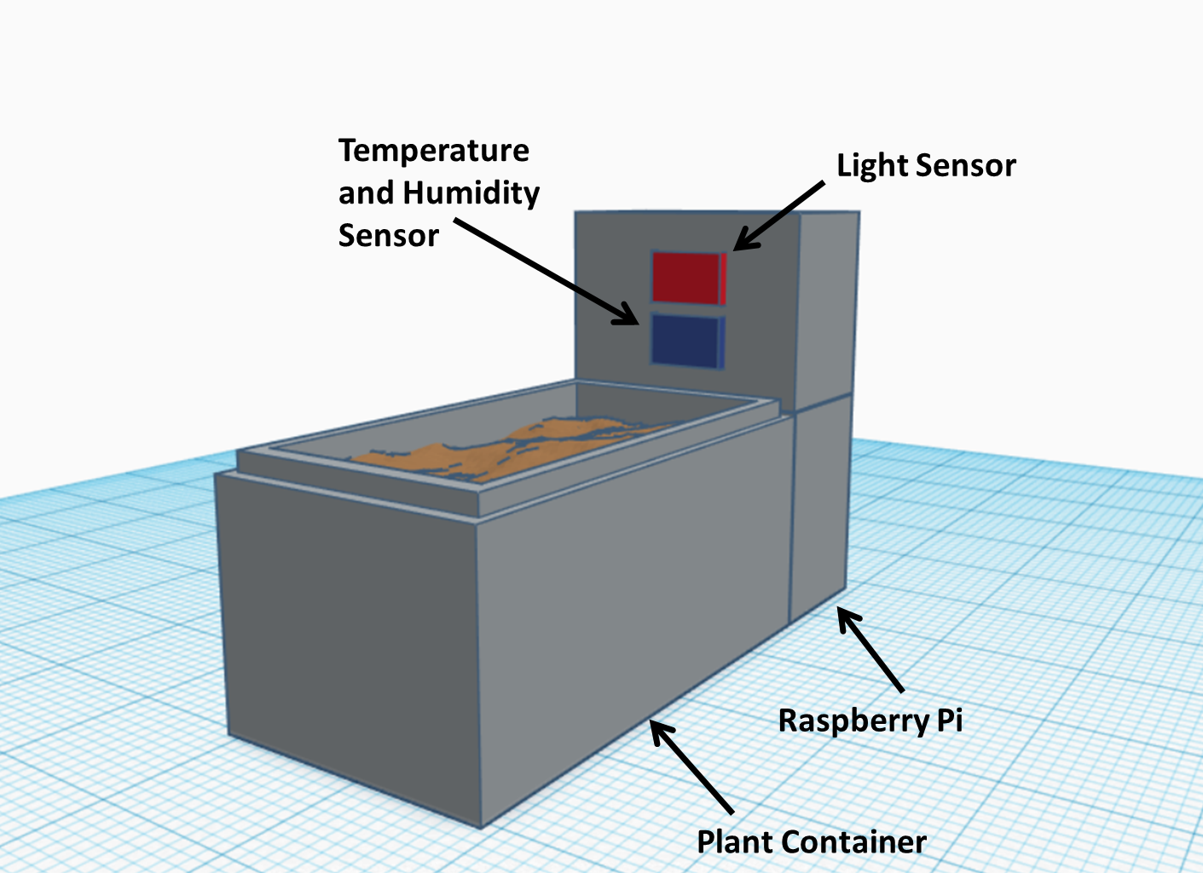
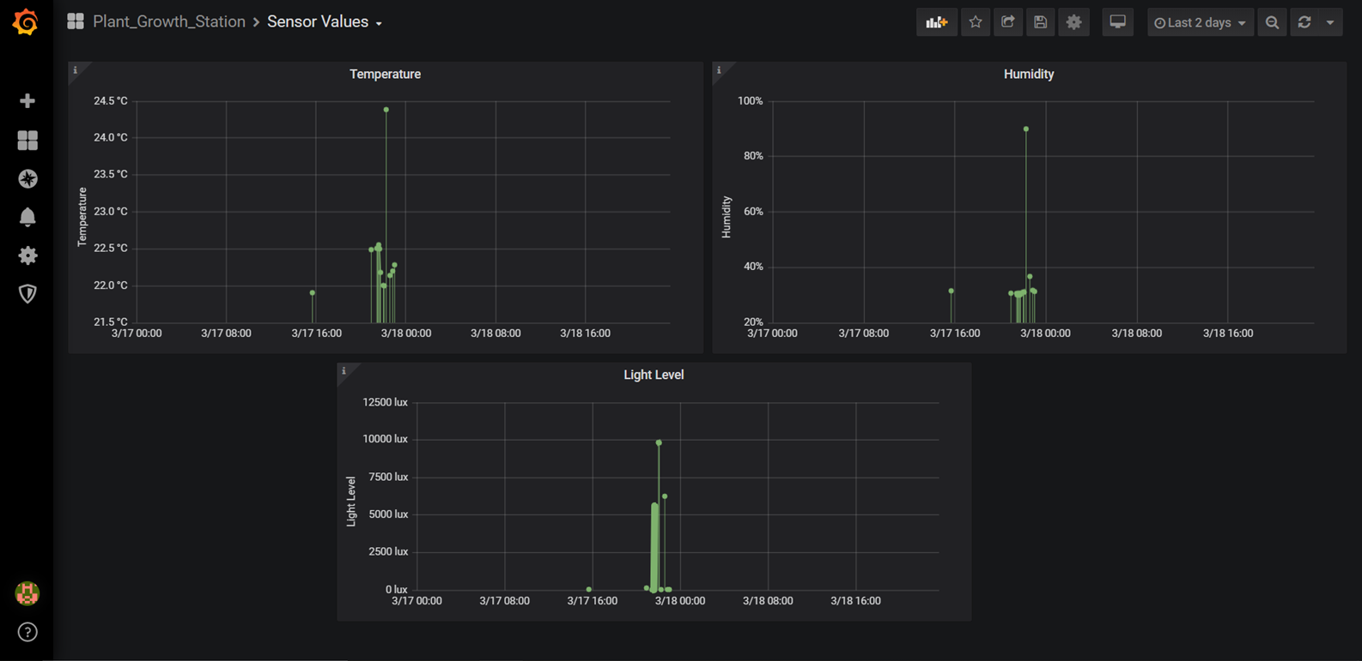
Product Design and architecture Overview
Sensor Data from Raspberry Pi
Web Application:
Website features
Email Services
Data Processing
Databases
User input through website
Visualization Platform

Slide 8
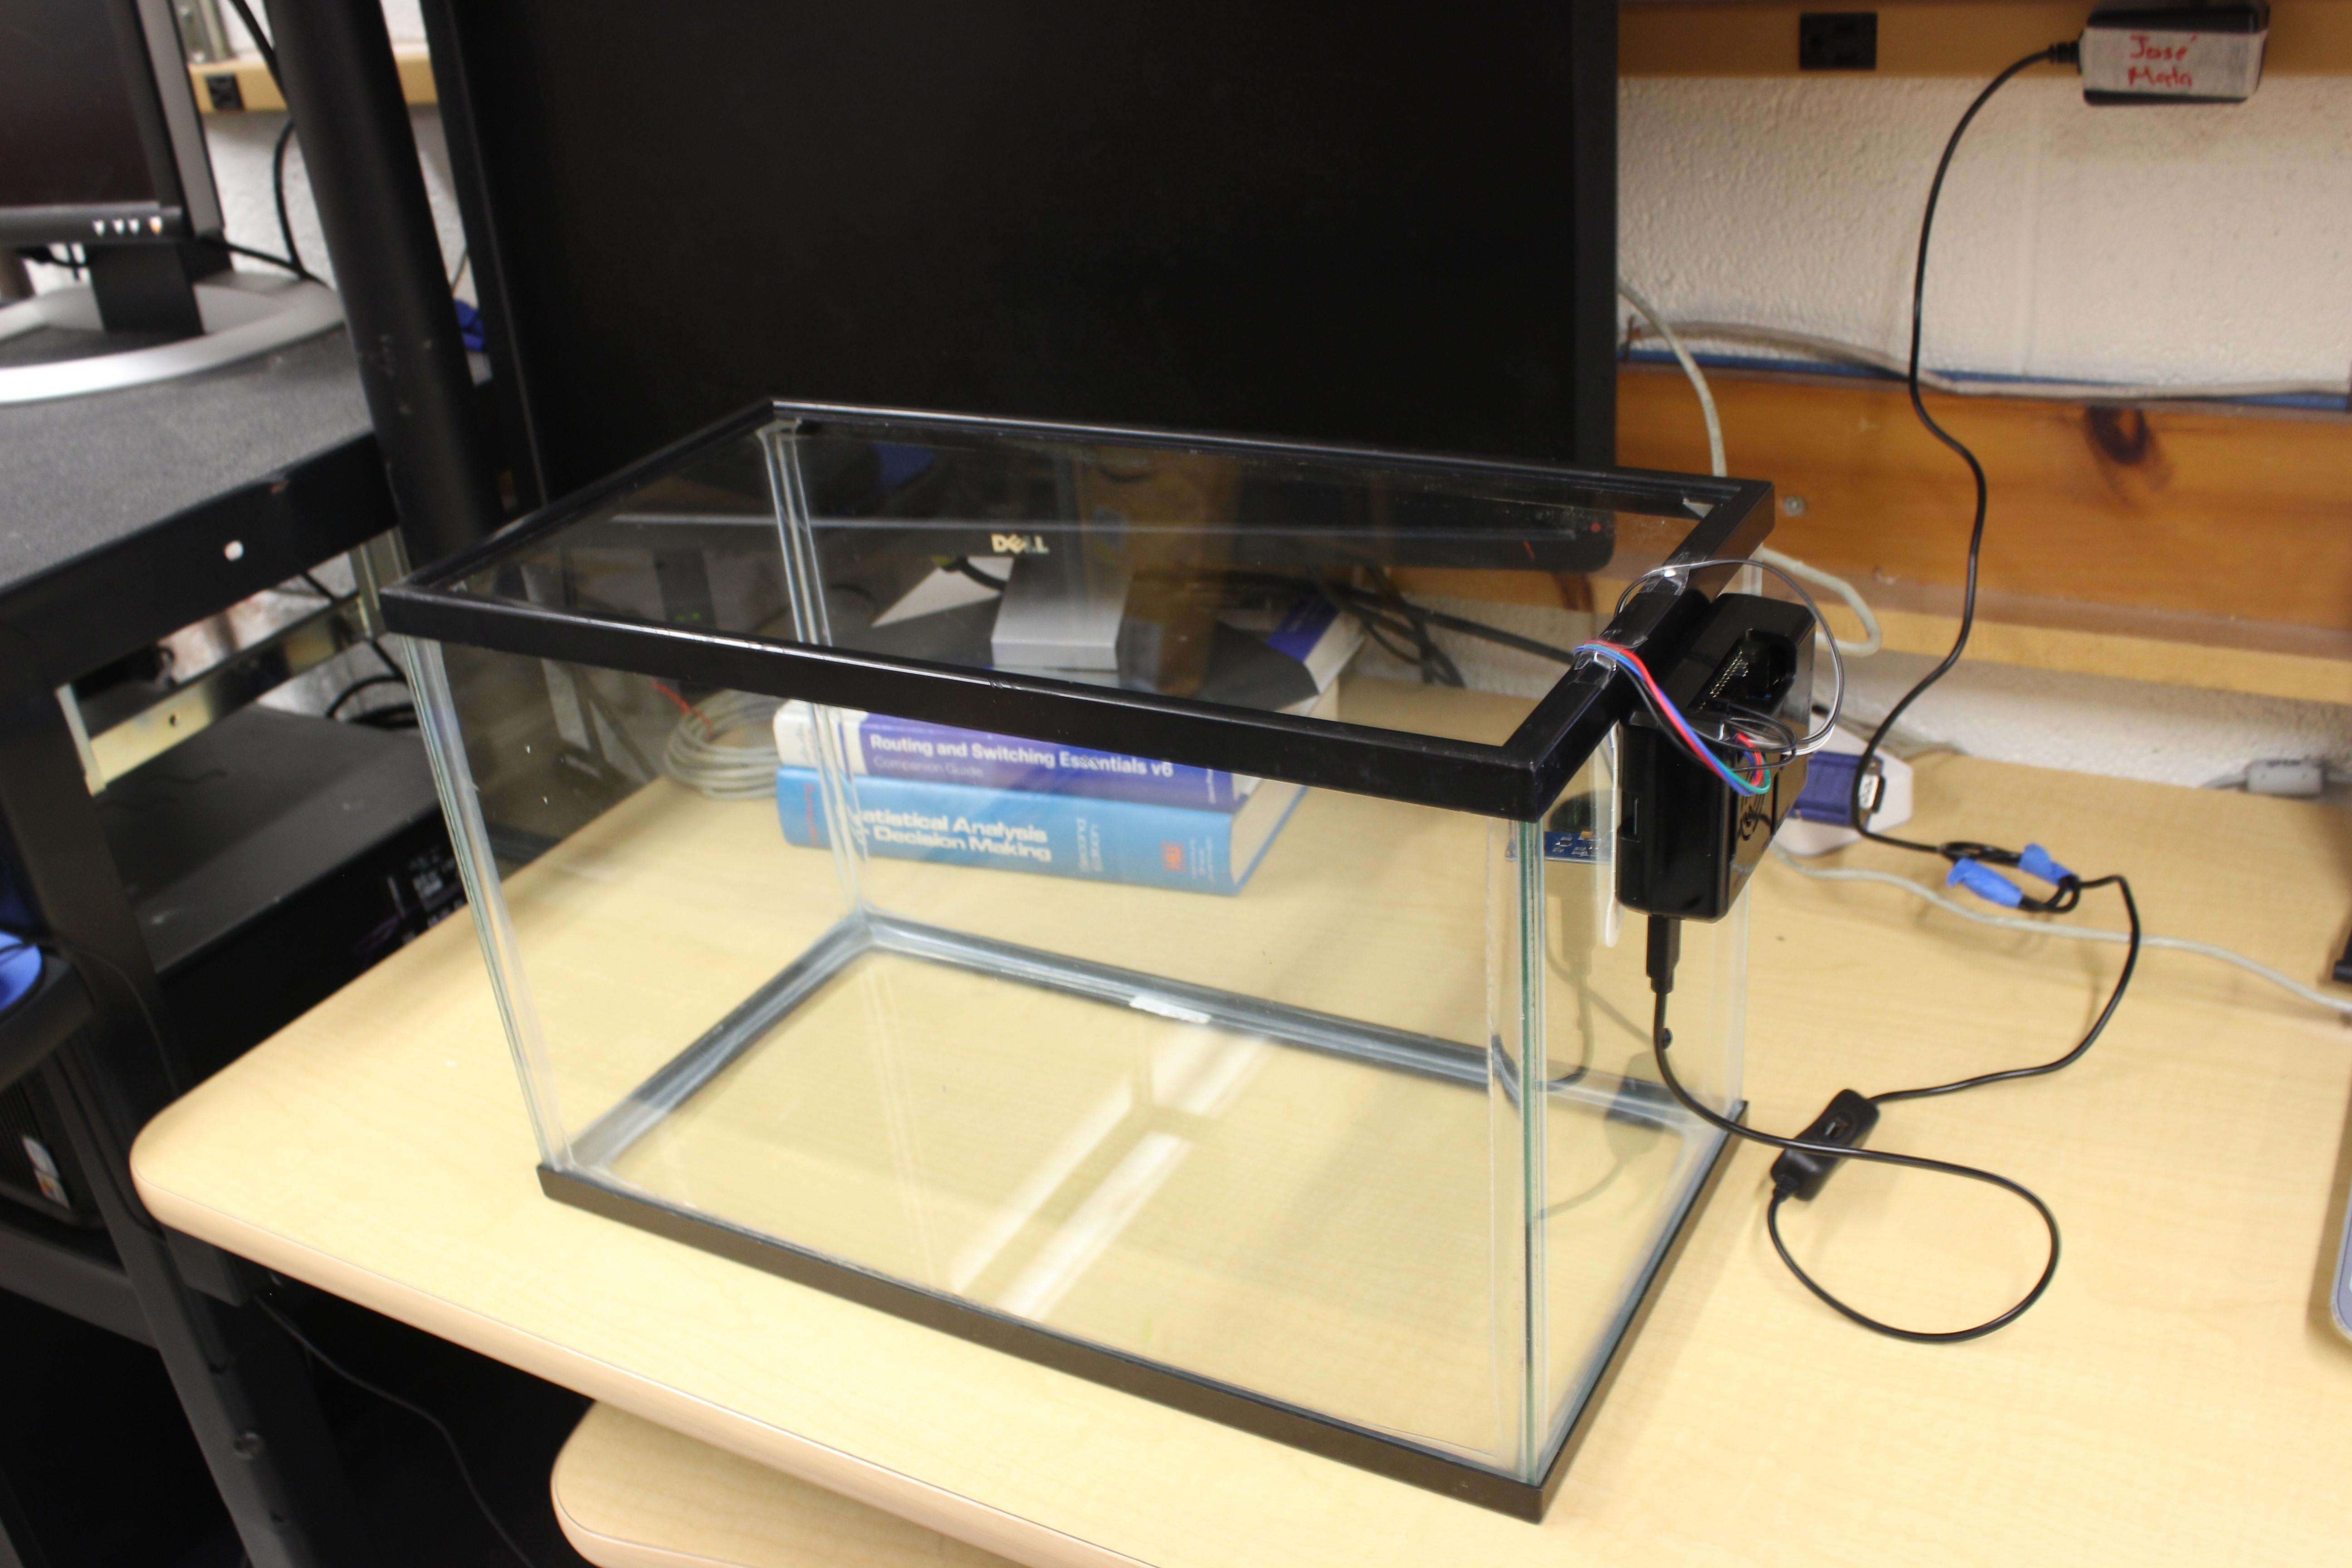
Device

Slide 9
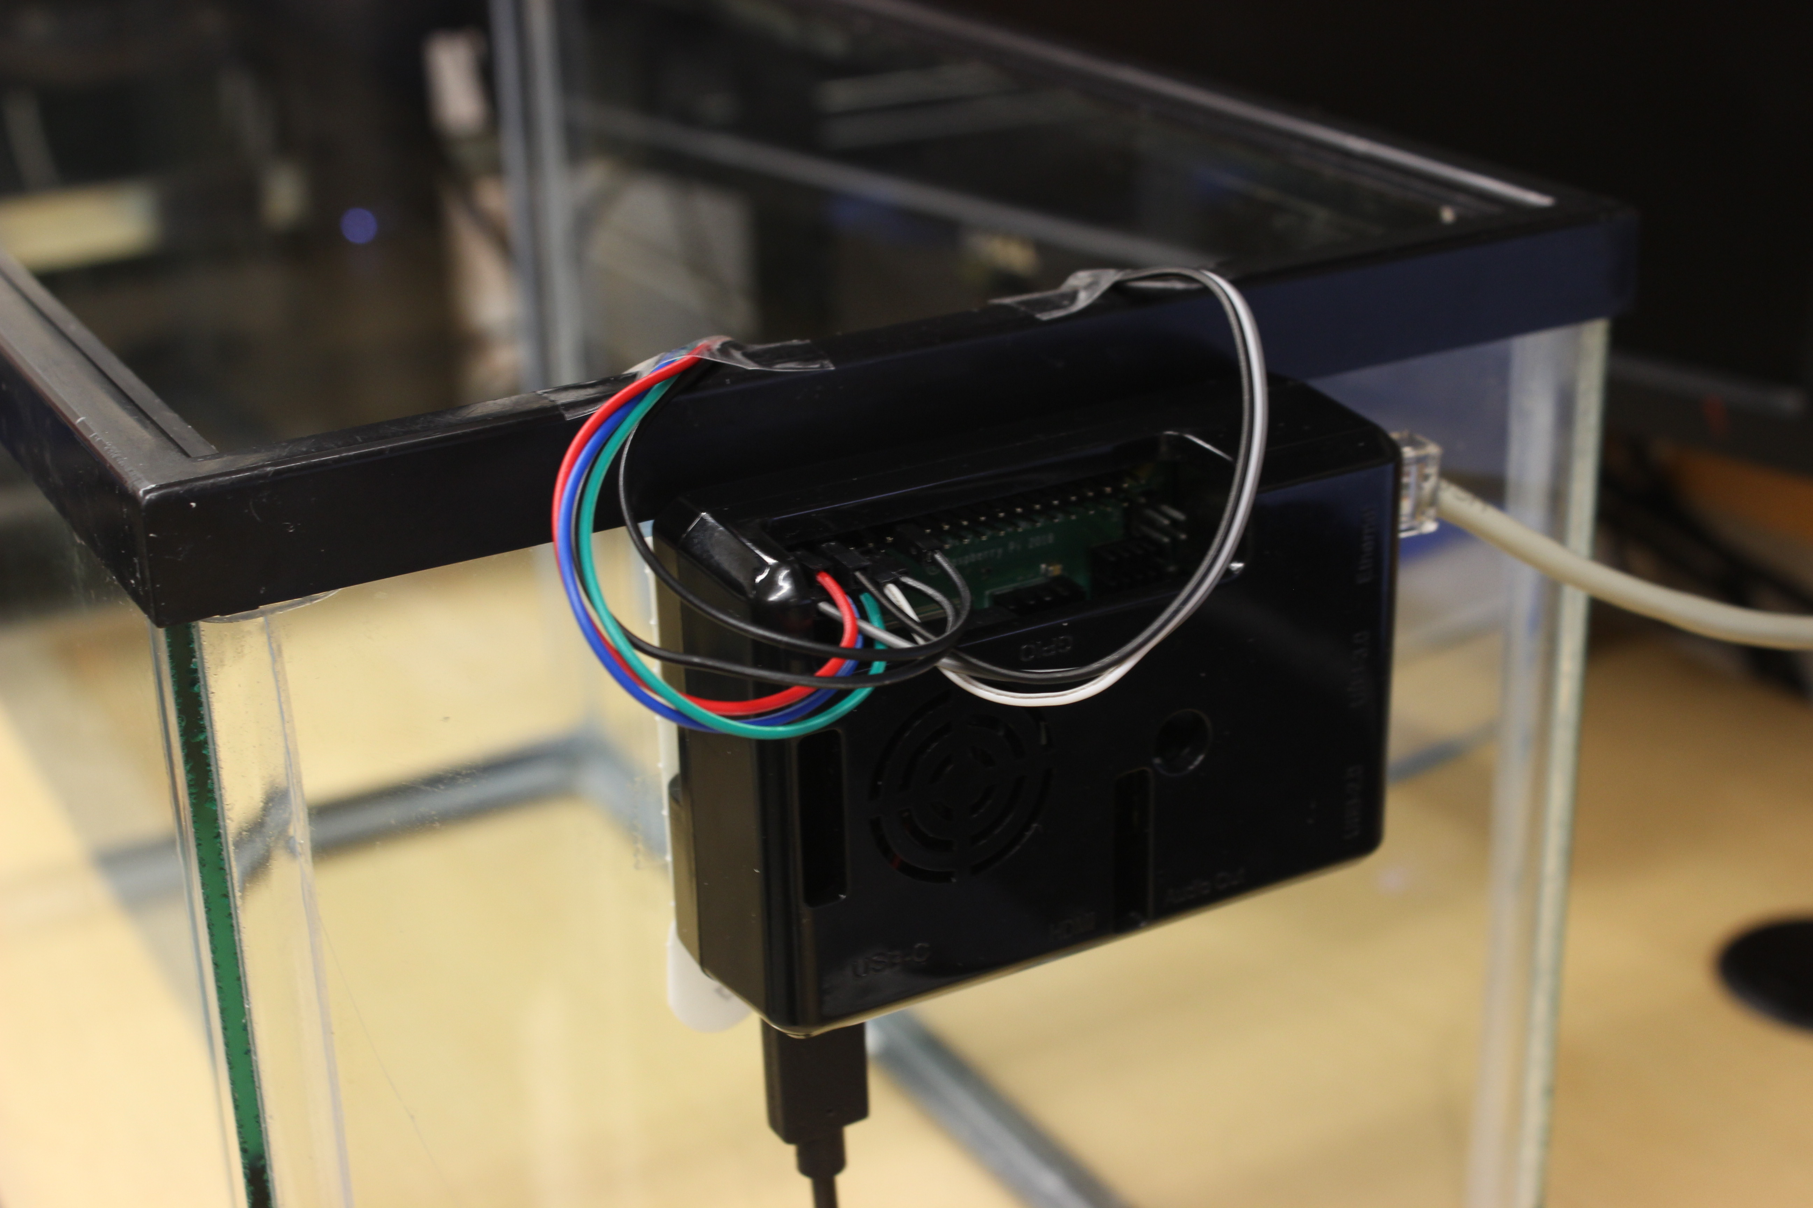
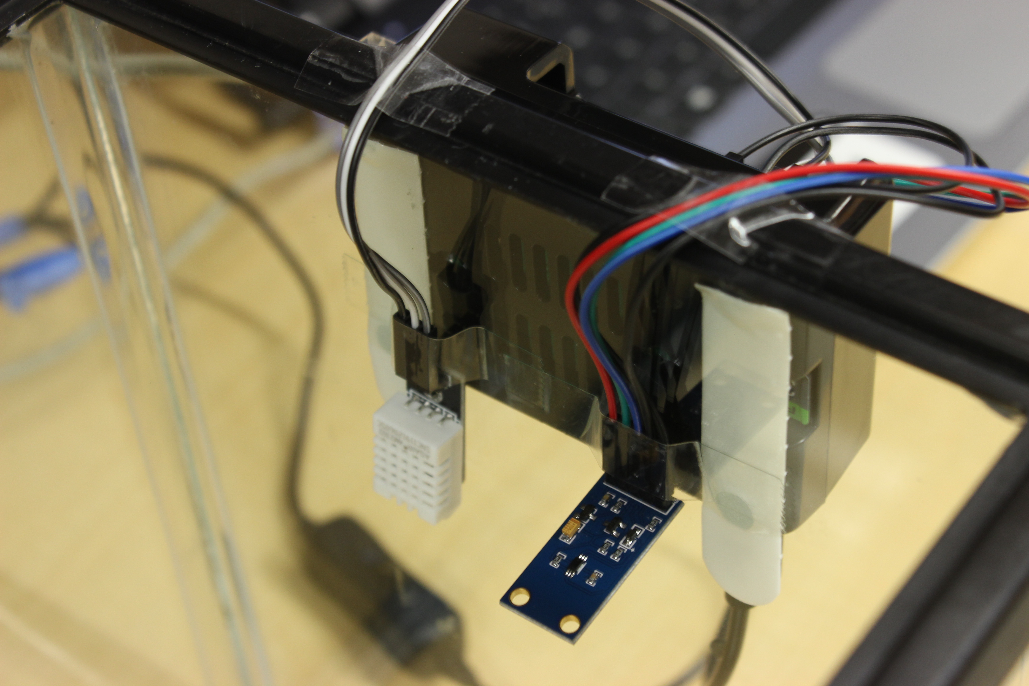
Device

Slide 10
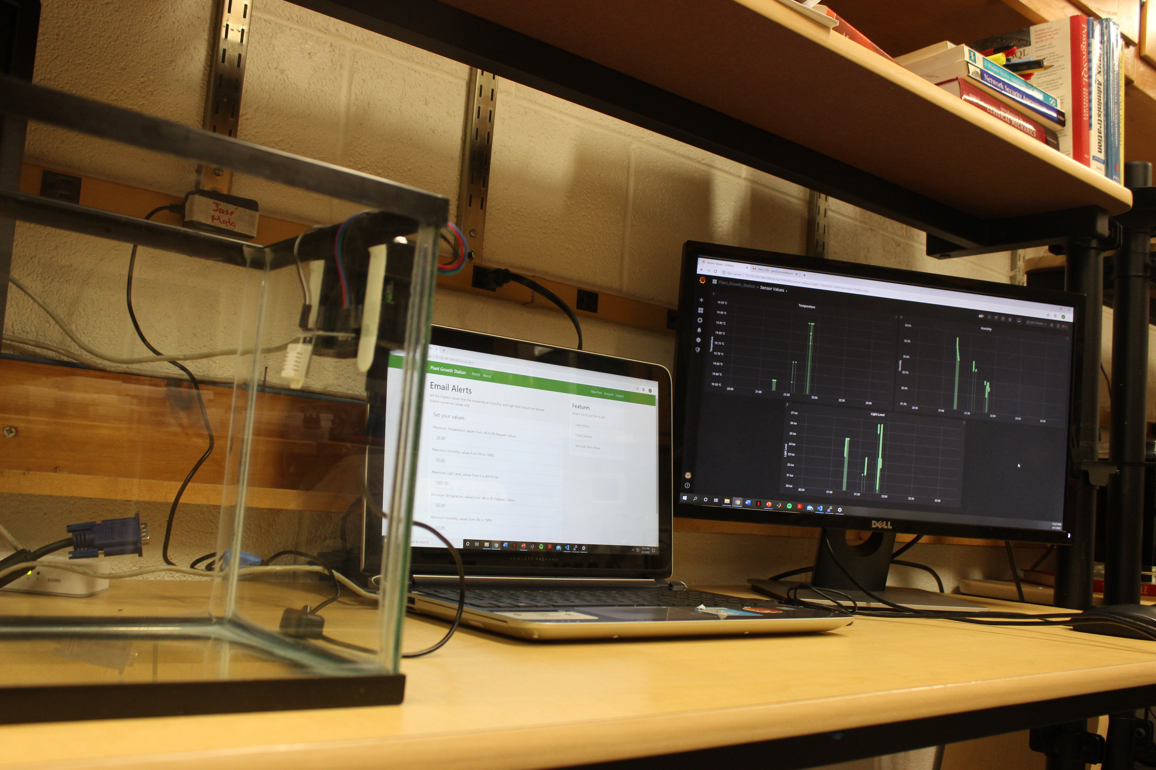
Device

Slide 11
COSTS
Raspberry Pi 4 Set – $70
32GB Memory Card – $4
Raspberry Pi Sensors – $10
Plexiglass Container – $30
Total – $ 114

Slide 12
How the
Plant Growth Station
was Built

Slide 13
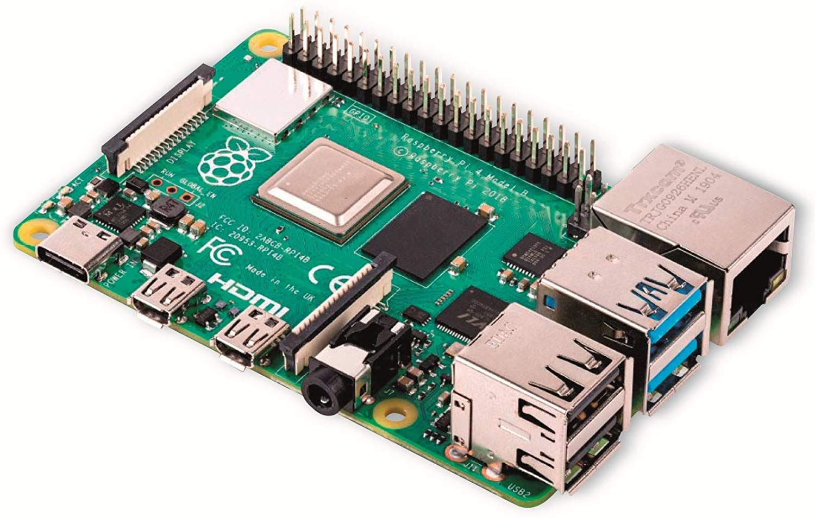
Raspberry PI4
Serves as the CPU of the PGS device.
4GB RAM
WiFi
Bluetooth 5.0
Ethernet
USB – 2 USB 3.0 ports; 2 USB 2.0 ports
GPIO header – Raspberry Pi standard 40 pin

Slide 14
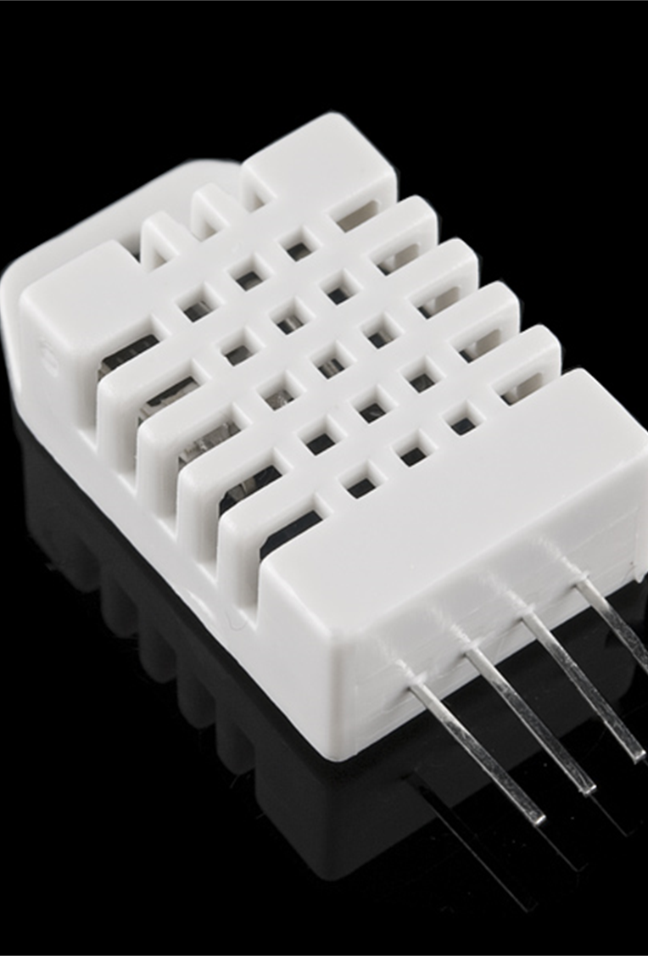
DHT22: Temperature and Humidity Sensor
Operating Voltage: 3.5V to 5.5V
Operating current: 0.3mA (measuring) 60uA (standby)
Output: Serial data
Temperature Range: -40°C to 80°C
Humidity Range: 0% to 100%
Resolution: Temperature and Humidity both are 16-bit
Accuracy: ±0.5°C and ±1%

Slide 15
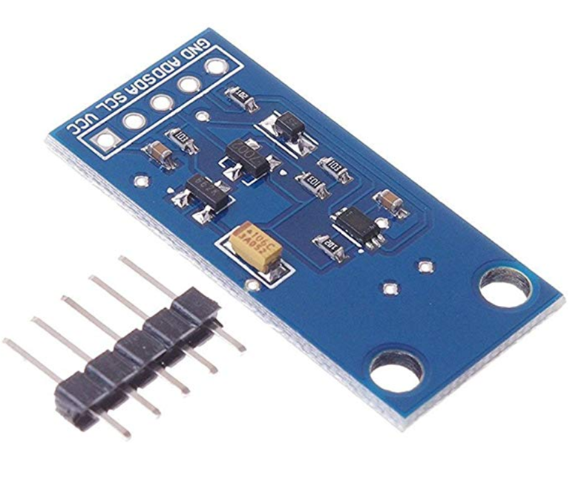
BH1750: Light Level Sensor
Power supply :3-5v
Illumination range :0-65535 lx
The sensor built 16bitAD converter
Net Weight : 2g

Slide 16
Development environment & Resources
ENC Linux Server
Flask Framework
Python
Cron Jobs
SQL Database
Influx Database
Grafana
GitHub

Slide 17
The Plant Growth Station Website

Slide 18
The Plant Growth Station Website DEMO
(Video on Canvas)

Slide 19
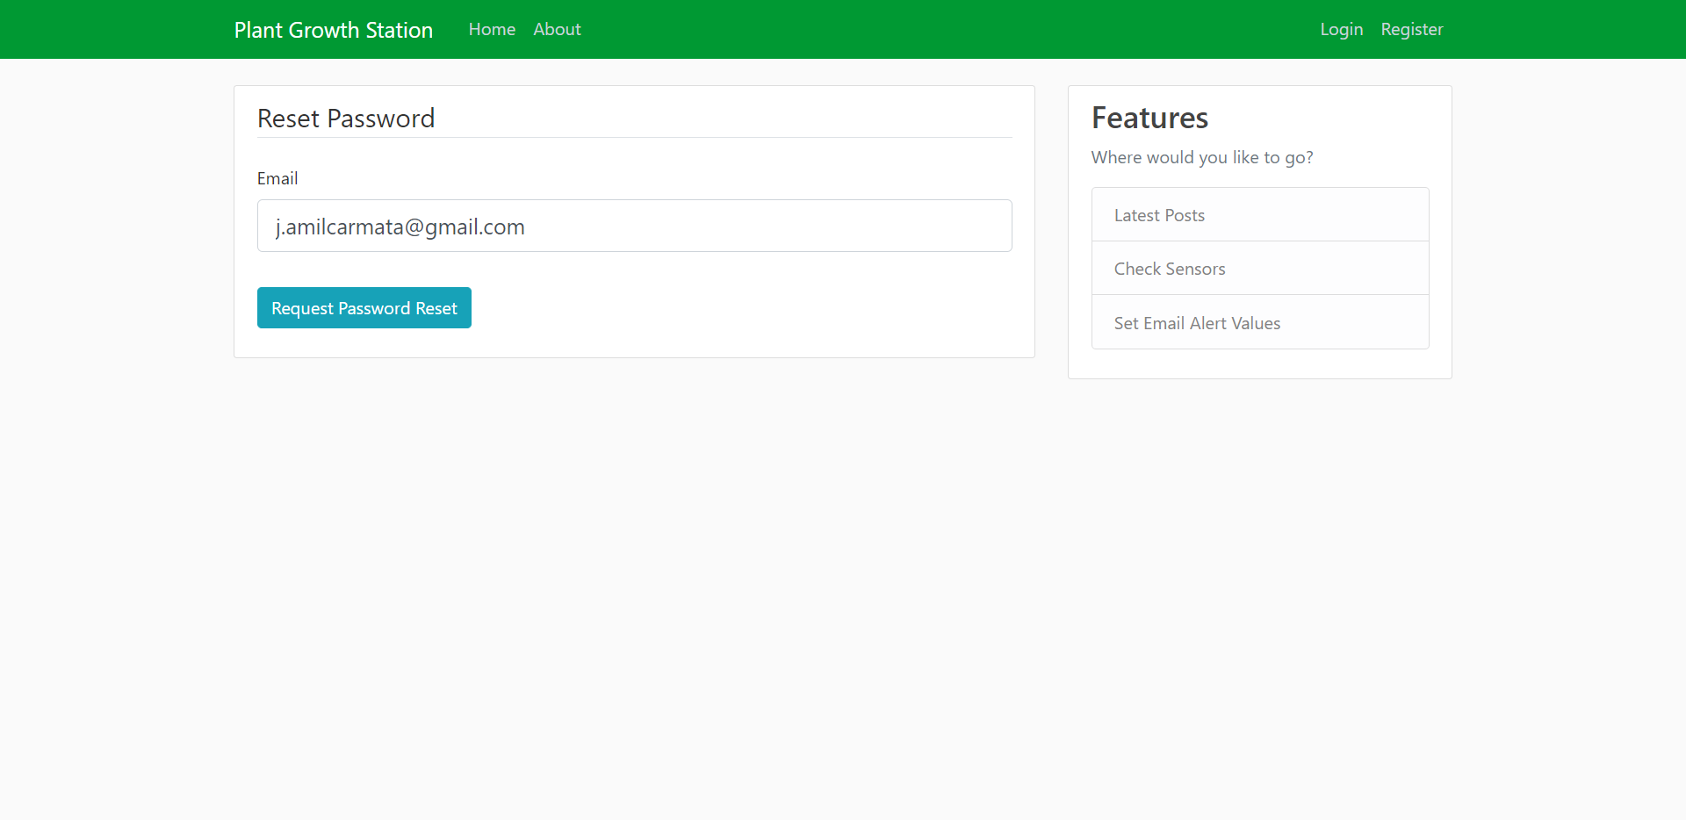
Password Reset

Slide 20
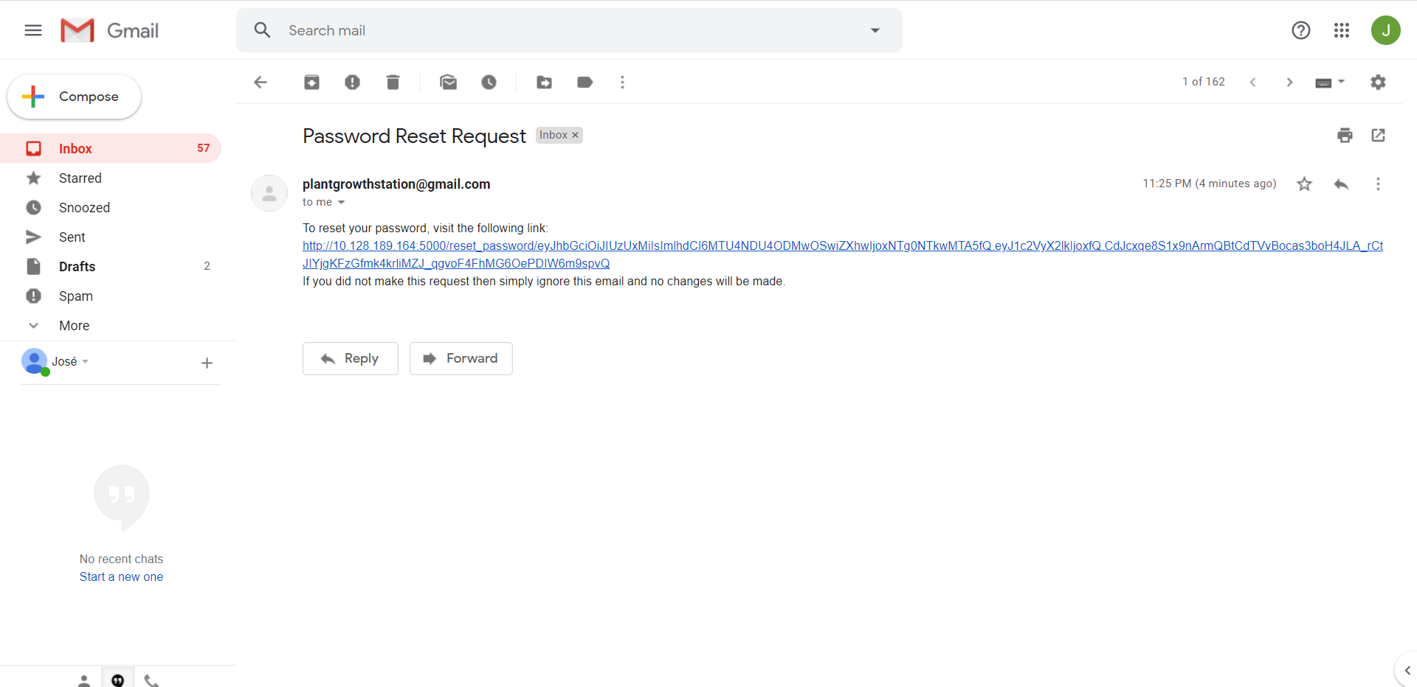
Password Reset

Slide 21
The Plant Growth Station Device DEMO
(Video on Canvas)

Slide 22
The Plant Growth Station Email Alert DEMO
(Video on Canvas)

Slide 23
Daily eMail Report

Slide 24
Conclusions
The PGS is fully functional:
Allows users to monitors their plant’s conditions in near real-time.
Includes user account creation and personalization.
Allows for personalized email alerts.

Slide 25
Future IMPROVEMENTS
Wi-fi implementation of the product (deployment in Google Cloud).
Database of plants and their optimal growing conditions.
Automated threshold values depending on the type of plant grown.

Slide 26
Acknowledgements
Thank you to:
God Dr. Pierre-Richard Cornely
Family and friends

Slide 27
References
Components 101. (2018, April 19). DHT22 – Temperature and Humidity Sensor. Retrieved from components101.com
HiLetgo. HiLetgo GY-30 BH1750FVI Digital Light Intensity Sensor Module, Amazon.com
Schafer, Corey. Code Snippets from GitHub account. Retrieved from github.com/CoreyMSchafer/code_snippets
The Raspberry Pi Foundation. Raspberry Pi 4 Tech Specs. Retrieved from raspberrypi.org

Slide 28
Questions?
“Creativity is thinking up new things. Innovation is doing new things.”
Theodore Levitt (1925 – 2006), Renown economist

