Slide 1
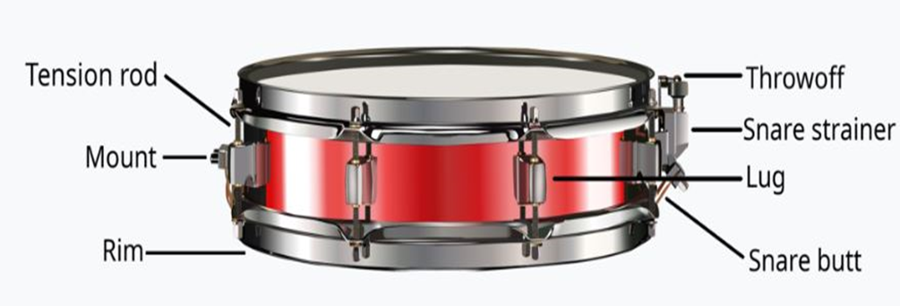
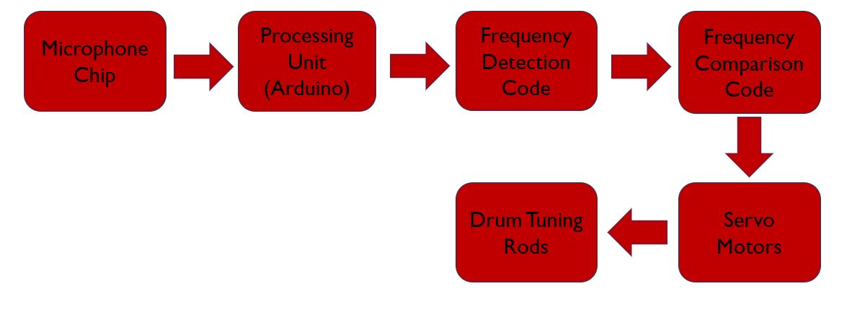
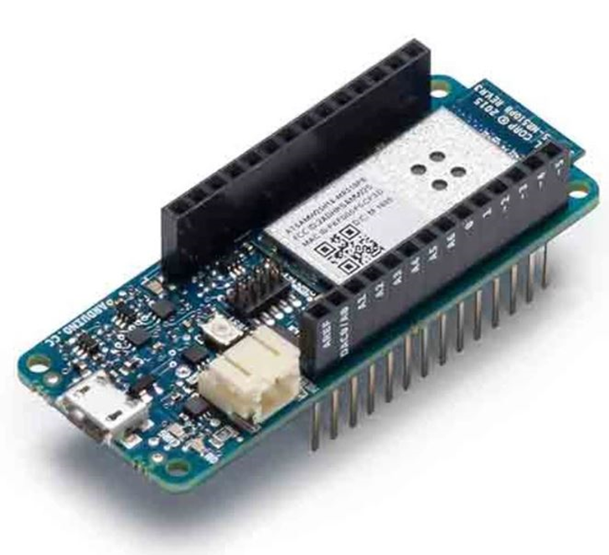
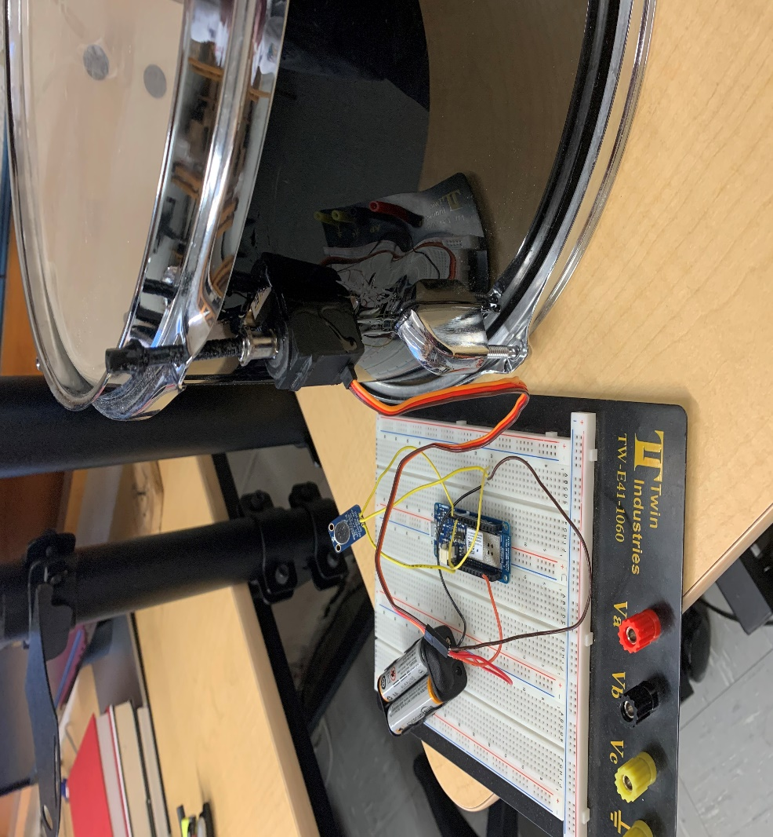
Automated Drum Tuning System
Kaleb Golden
Physics & Engineering Department, Eastern Nazarene College
Abstract
Tuning drums is one of the worst possible things you could ever have to endure as a drummer, it’s a time consuming, arduous process that takes precious time a drummer could be spending practicing, especially when the drummer has to change heads. The question is then, how do we keep the drum tuned and sounding exactly the way we want it to without having to do it ourselves? In this project, a system was developed that can actively search and detect the drum’s frequency and then tune the drum to a designated frequency range set by the user. For a problem of this sort, a hybrid research method was used that included both my own ideas, as well as already existing technology and resources. The proposed system uses the audio processing features with the Simple Audio Frequency Sensor library of an Arduino MKR1000, as well as a microphone chip to be able to detect the sound input. The system also uses a drum and a servo motor that attaches to the drum. The servo and drum system are interfaced with tuning rods for automatically tuning the drum to a drummer specified set of sounds (frequencies). The system was effectively tested using given resources and shown to achieve a range of user specified tuning frequencies. While the product is still very much in its prototyping phase, the contribution of this product to the field of music could revolutionize the way drums are manufactured for years to come.
Motivation
Drum History
Similar Products
System Requirements
Tuning drums, the bane of almost every drummer in the industry.
It can be a long and mentally arduous process takes precious time that could be used for practicing instead of sitting there turning a drum key.
How can we cut down or eliminate this issue?
The implementation of the tension rod and mount assembly in 1931 forever changed the way drums were made and influenced the advancement of music in ways unimaginable
The system shall [1] constantly and automatically monitor its tuning.
Drum shall[1.1] have a frequency sensor
Drum shall[1.2] have a processing unit
Drum shall[1.3] have motors to turn the tuning rods
The frequency sensor shall [2] be able to constantly monitor the frequency of the drum when struck.
The sensor shall[2.1] be mounted on the inside of the drum
The sensor shall[2.2] be connected to the processing unit
The sensor shall[2.3] output the frequency value to the processing unit
Typical hardware of a snare drum
There are other products that can detect the frequency of the drum, or even the note that corresponds to the frequency, but none can actively tune the drum as well
System Requirements
Architecture
Arduino IDE
Programming the Device
The processing unit shall [3] be able to covert frequency to voltage
The processing unit shall [3.1] have a frequency to voltage conversion program
The processing unit shall [3.2] be able to control the motors using code
The processing unit shall [3.3] obtain the frequency value through the frequency sensor
The motors shall [4] be mounted on the sides of the drum and attached to the tuning rods
The motors shall [4.1]be attached to the threaded tuning rods
The motors shall [4.2] be able to turn both directions to tighten and loosen the tuning rods
The motors shall [4.3] be able to run on less than 15 volts.
The Arduino IDE allowed me to program my product to actively search for a specific range of frequencies. After determining the frequencies the program would then move a servo in relation to whether the drum needs to be tuned higher or lower. .
Arduino is an open-source platform that allows Arduino boards to be programmed with the Arduino Integrated Development Environment (IDE) software.
Arduino Code
Arduino MKR1000
Final Design
The frequency detection code is comprised of 2 sections, obtaining the frequency from the microphone chip, and then outputting the data to the servo movement section
The servo movement section is comprised of a series of frequency value comparisons to successfully find the user frequency value and move the servos accordingly
The board controls both the microphone chip and motors of the device. It supplies a voltage to the microphone chip and the common ground for the chip and motors.
Conclusions
Future Work
Acknowledgements
Thank you to Dr. Pierre-Richard Cornely and my friends and family for all of their love and support through the creation of the product..
Created a prototype that can accurately measure frequency and move the tuning rod accordingly depending on the set frequency value.
With further funding and work, this could be a fully flushed out product with the potential change the drum market for years to come.
Continue to improve the frequency detection system to give accurate results more consistently.
Acquire a patent for the product (In progress)
Improve the overall housing of the system
Improve the ability for the system to integrate into typical drum shells

Slide 2
Motivation
Tuning drums, the bane of almost every drummer in the industry.
It can be a long and mentally arduous process takes precious time that could be used for practicing instead of sitting there turning a drum key.
How can we cut down or eliminate this issue?

Slide 3
Background
The implementation of the tension rod and mount assembly in 1931 forever changed the way drums were made and influenced the advancement of music in ways unimaginable
Typical hardware of a snare drum

Slide 4
Similar Products
There are other products that can detect the frequency of the drum, or even the note that corresponds to the frequency, but none can actively tune the drum as well

Slide 5
System Requirements
The system shall [1] constantly and automatically monitor its tuning.
Drum shall[1.1] have a frequency sensor
Drum shall[1.2] have a processing unit
Drum shall[1.3] have motors to turn the tuning rods
The frequency sensor shall [2] be able to constantly monitor the frequency of the drum when struck.
The sensor shall[2.1] be mounted on the inside of the drum
The sensor shall[2.2] be connected to the processing unit
The sensor shall[2.3] output the frequency value to the processing unit

Slide 6
System Requirements
The processing unit shall [3] be able to covert frequency to voltage
The processing unit shall [3.1] have a frequency to voltage conversion program
The processing unit shall [3.2] be able to control the motors using code
The processing unit shall [3.3] obtain the frequency value through the frequency sensor
The motors shall [4] be mounted on the sides of the drum and attached to the tuning rods
The motors shall [4.1]be attached to the threaded tuning rods
The motors shall [4.2] be able to turn both directions to tighten and loosen the tuning rods
The motors shall [4.3] be able to run on less than 15 volts.

Slide 7
Architecture

Slide 8
Arduino IDE + Programming
Arduino is an open-source platform that allows Arduino boards to be programmed with the Arduino Integrated Development Environment (IDE) software.
The Arduino IDE allowed me to program my product to actively search for a specific range of frequencies. After determining the frequencies the program would then move a servo in relation to whether the drum needs to be tuned higher or lower.

Slide 9
Product Code
The frequency detection code is comprised of 2 sections, obtaining the frequency from the microphone chip, and then outputting the data to the servo movement section
The servo movement section is comprised of a series of frequency value comparisons to successfully find the user frequency value and move the servos accordingly

Slide 10
Arduino MKR1000
The board controls both the microphone chip and motors of the device. It supplies a voltage to the microphone chip and the common ground for the chip and motors.

Slide 11
Final Product

Slide 12
Conclusions
Successfully created a prototype that can accurately measure frequency and move the tuning rod accordingly depending on the set frequency value.
With further funding and work, this could be a fully flushed out product with the potential change the drum market for years to come.

Slide 13
Future Work
Continue to improve the frequency detection system to give accurate results more consistently.
Acquire a patent for the product (In progress)
Improve the overall housing of the system
Improve the ability for the system to integrate into typical drum shells

Slide 14
Acknowledgments
Thank you to Dr. Pierre-Richard Cornely and my friends and family for all their love and support through the creation of the product..

