Slide 1
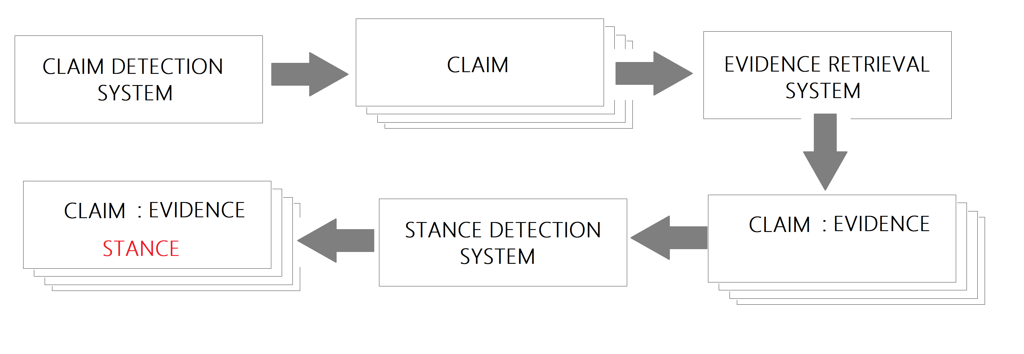
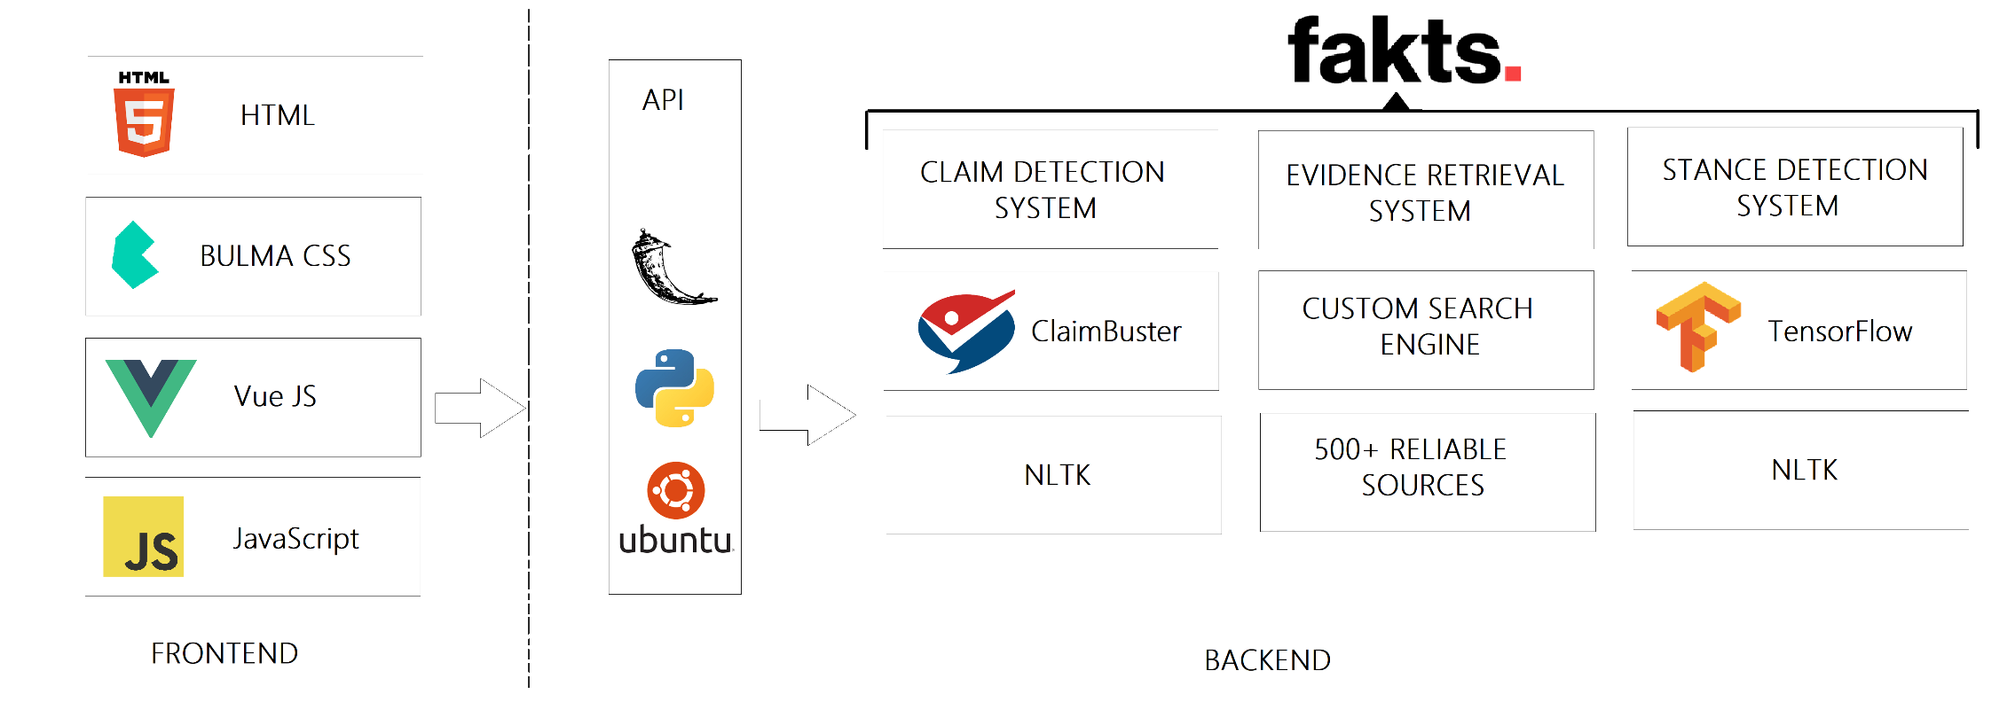
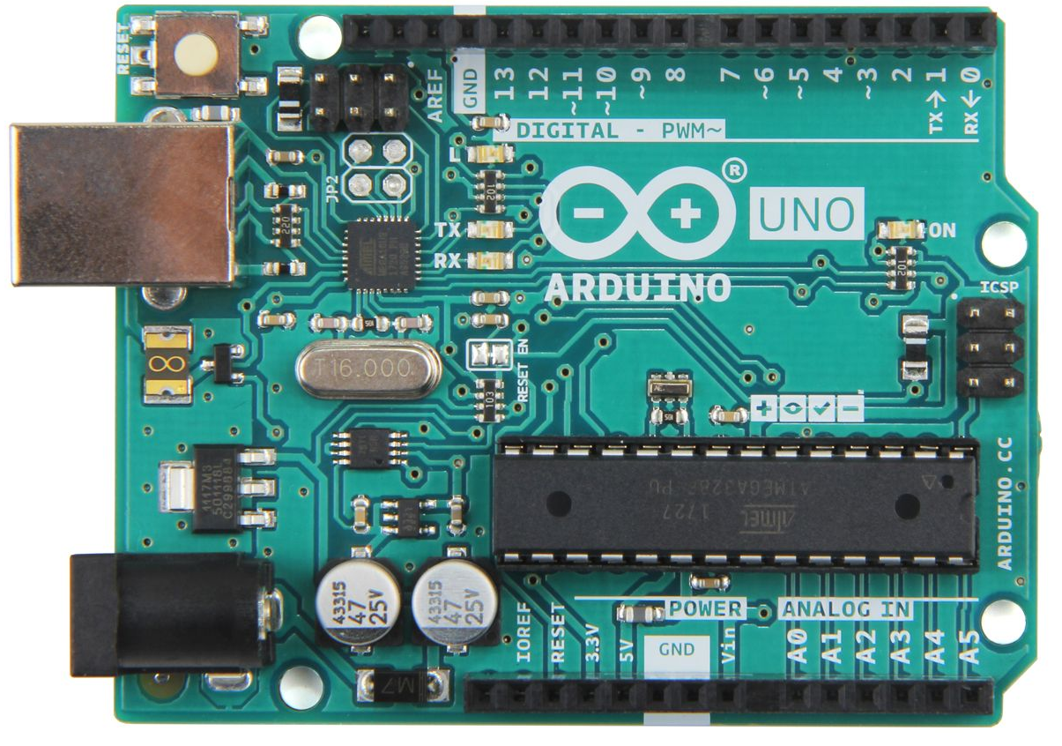
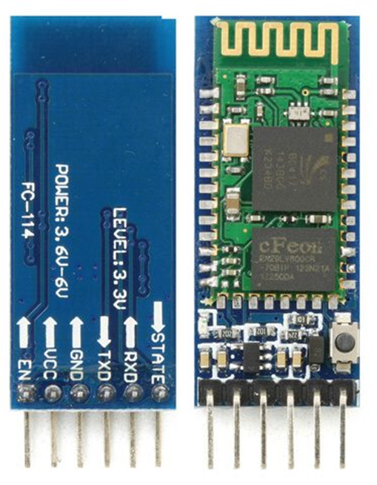
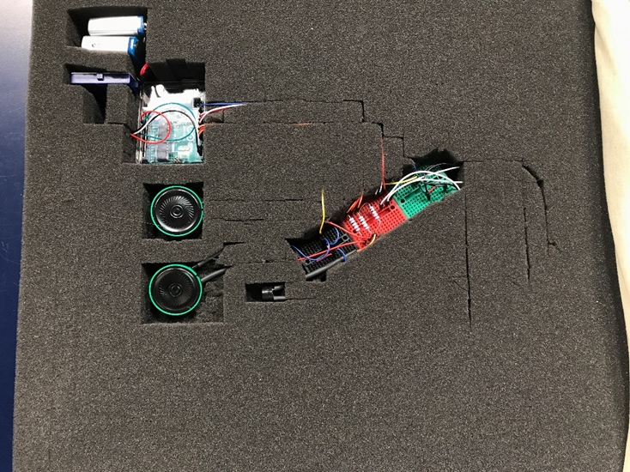
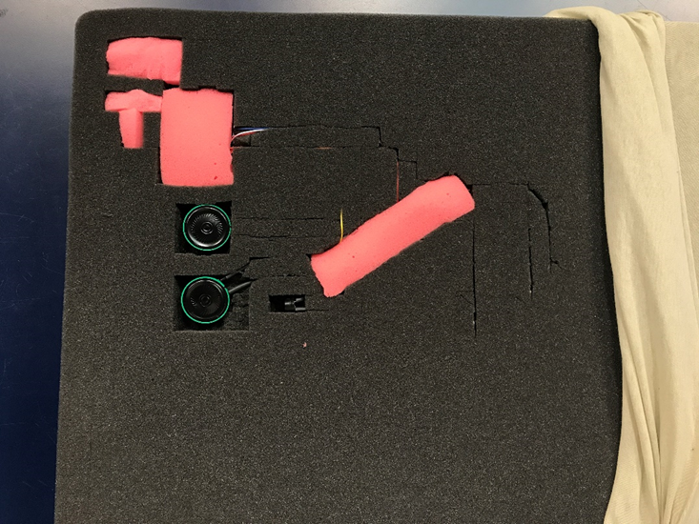
The Wake-Up Pillow
Brent Houle
Physics & Engineering Department, Eastern Nazarene College
Abstract
The spread of false and incomplete information is breaking our democracy, dividing our society, and jeopardizing our judgment. As a result, there has been a proliferation of fact-checking organizations, attempting to manually determine the veracity of online information. Nevertheless, this method is known to be time-consuming, expensive, and unscalable. Moreover, these evaluations often involve articles that have been widely consumed and shared by the time they are assessed. This project is striving to provide automated fact-checking tools that can inform users of false or incomplete assumptions or claims within an article anywhere online in a speedy manner. We see this as a steppingstone towards a complete set of tools (web extensions, browser plug-ins, embedded scripts, etc.) that will help expose online misinformation at scale.
Motivations
The Need for Automation
Fact Checking Steps
Introducing: Fakts
1. The spread of false and incomplete information is breaking our democracy, dividing our society, and jeopardizing our judgment.
2. 62% of U.S. adults get their news on social media, and he most popular fake news stories of 2016 were more widely shared on Facebook than the most popular mainstream news stories.
Manual fact-checking is time-consuming, expensive, and unscalable.
Evaluated articles have been widely consumed and shared by the time they are assessed.
1. Claim Selection
Detect research-worthy claims
2. Evidence Extraction
Get reputable documentation
3. Support/Debunk Labeling
Is the documentation supporting or debunking the claim?
Fakts is on a mission to prevent the proliferation of false and incomplete knowledge globally.
Vision and Goals
Mimicking The Process
Architecture
Tech Stack
To expose misinformation at scale.
2. For anyone to know the veracity of any online article with our AI-powered fact-checking assistant.
Main Languages: Python, JavaScript.
Databases: PostgreSQL, MongoDB
REST API: Flask
UI: VueJS
NLP: NLTK
AI/DL: TensorFlow
CI/CD, DevOps: Jenkins, Docker, Kubernetes
Programming the Device
Arduino Uno
HC-05 BT Module
Assembling the Prototype
The board controls the speakers and motors of the device. It supplies a voltage to the designated pins to turn the hardware on and off when an alarm is triggered. This particular board was chosen because it is inexpensive but boasts high functionality
This module is what allows the user to control the device from their smartphone. Through a Bluetooth connection the HC-05 relays serial commands from the phone app to the Arduino Uno.
Arduino is an open-source platform that allows Arduino boards to be programmed with the Arduino Integrated Development Environment (IDE) software.
These pictures show the layout of the internal components of the device. The delicate components are covered with soft pieces of foam for protection and comfort.

